Slide 1
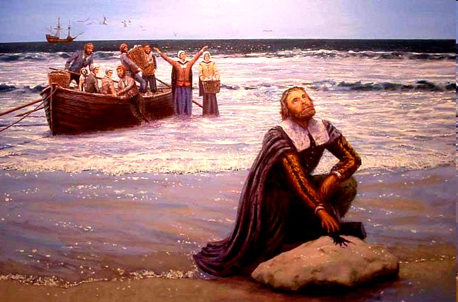
The Age of Faith & The Puritans 1620-1750

Slide 2
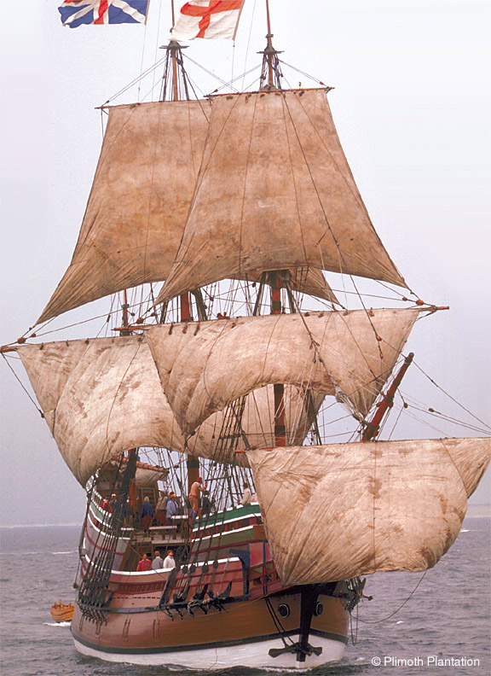
Texts we will be covering: Of Plymouth Plantation - History Here Follow Some Verses Upon the Burning of our House - Poem Huswifery - Poem
As Weary Pilgrim - Poem
Puritan Woman - Poem Sinners in the Hands of an Angry God - Sermon Young Goodman Brown – Short Story

Slide 3
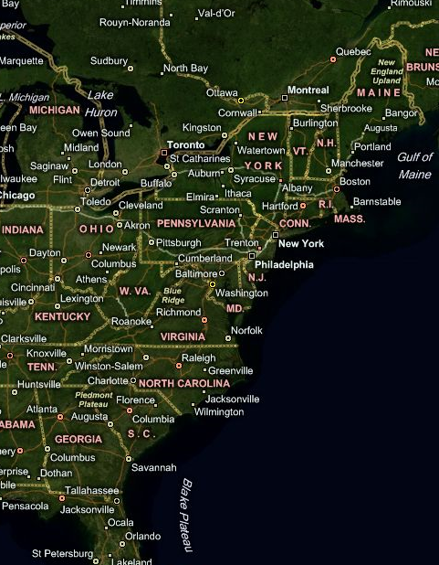
A Pilgrimage
The Puritans leave England for Holland in 1608 to escape religious persecution
Fearing a loss of British identity, the Puritans request and are granted a charter in the “New World”
The Mayflower leaves England on September 6 and arrives at Cape Cod on November 9, 1620 – Journey: 66 Days
Saw their journey as both physical and spiritual
★

Slide 4
Puritanism
Puritans stressed
Hard work
Self-discipline
Education
Self-reliance
Frugality
Self-improvement
These values are the basis for what are considered “American virtues
Puritans were 1st American writing to influence course of American literature & American imagination.

Slide 5
Puritan Beliefs – Fundamentalism
Sinners All
Through Adam & Eve’s fall Every person is born sinful
Original Sin: Consequence of Adam and Eve’s sin: Tasting of the tree of knowledge of good and evil – the hereditary stain with which we are born on account of our origin or descent from Adam and Eve.
UNCONDITIONAL ELECTION
Judgmental God (rewards good/punishes evil) wishes
Predestination/Election (salvation or damnation was predetermined by God)
The Elect = One predestined to go to Heaven

Slide 6
Puritan Beliefs
EXPERIENCING GOD’S GRACE
God’s Grace (only select individuals could experience this miracle of God’s love)
Guilt & remorse were signs of God’s Grace
Other Signs: Altruism & benevolence, being of a helpful, caring, and extroverted personality
In the end, there was no sure way to know
Repentance, like personal salvation, depended on the Grace of God
LIMITED ATONEMENT
Jesus died for the “chosen” only, not for everyone – For The Elect
So, how was one to know if they were one of the elect?

Slide 7
Puritan Beliefs
Those who are elected by God have full power to interpret the will of God – Only the Elect could be a priest or minister
The Bible is the supreme authority on earth and cannot be questioned or refuted
They used the Bible to justify their occupation of the land and their use of force against Native Americans

Slide 8
“CITY UPON A HILL”
You are the light of the world. A city set on a hill cannot be hid. Nor do men light a lamp and put it under a bushel, but on a stand, and it gives light to all in the house. Let your light so shine before men, that they may see your good works and give glory to your Father who is in heaven."
-- Jesus, from the Sermon on the Mount, Matthew 5:14-16.
"For we must consider that we shall be as a city upon a hill, the eyes of all people are upon us; so that if we shall deal falsely with our God in this work we have undertaken, and so cause Him to withdraw His present help from us, we shall shame the faces of many of God’s worthy servants, and cause their prayers to be turned into curses . . ."
--John Winthrop, aboard the Arbella, 1630.
Winthrop and the Puritans saw themselves and their community as that “City upon a hill”

Slide 9
Additional Beliefs
Typology: God’s intentions are present in human action and in natural phenomenon
God’s wrath and reward present in natural phenomenon
The hand of God is present in everyday life and all events were of God’s doing
Backsliding: Belief that “saved” believers with visible signs of grace, can fall into temptation and become sinners – revert to original state

Slide 10
Signs of Puritan Decay
Presence of “heretics” – those who speak out against the orthodoxy or dogma of their religious beliefs
Violations of the Sabbath and swearing and sleeping during sermons
Sins of sex (lechery) and alcohol on the increase
Lacking in social behavior – introverts were shunned

Slide 11
Puritan Writing
PROTESTANT: against complicated writing
Plain Style: Uncomplicated sentences, use of everyday words
PURPOSIVENESS: Purpose to Puritan writing
Transform a mysterious God
Make God more relevant to the universe
Glorify God
Also, to catalogue important information relevant to an agrarian society: first/last frost, planting and harvest dates
CHARACTER: Reflected the literate and well-grounded principles instilled in the Puritan persona

Slide 12
Characteristics of Puritan Writing
Puritans saw direct connections between Biblical events and their own lives – reflected in their writing
Explore their inner and outer lives for signs of the workings of God.
Diaries and Histories most common forms of writing in Puritan society

Slide 13
The Salem Witch Trials
Fundamentalism – All portions of Bible are fact, so if The Bible speaks of witches, they must exist– to not believe in witches was heresy
Exodus 22:18 – Thou shalt not suffer a witch to live
Women thought most likely to become witches
1: Thought to be inherently lustful – even for the Devil
2: Couldn’t be members of the clergy, therefore, further from God

Slide 14
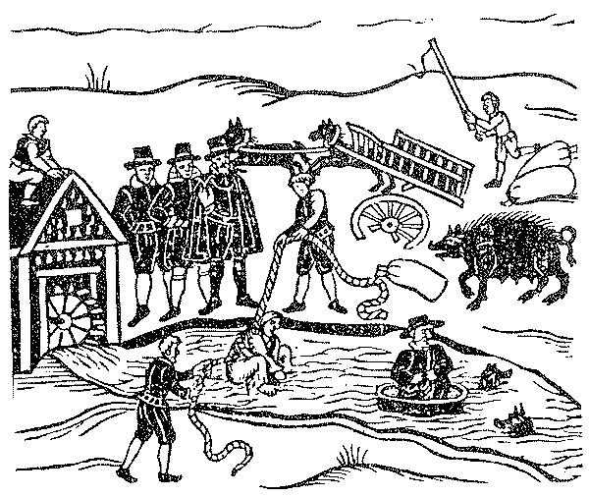
The Salem Witch Trials
Testing for signs of witchery
1: Checking for witches “teats”
Moles and birthmarks would be checked (stripped and shaved) for malignance: poked with a needle; if no blood/pain then malignant
2: Swimming a witch
Hands and feet would be bound and body thrown into a river/stream
Water, a pure element, would reject sin
Floater = witch = dead
Sinker = innocent = drowned

Slide 15
The Salem Witch Trials
Began in late 1691
First accusations were of the poor and the aged
Young girls (14-20) provided the majority of the accusations – some think Reverend Paris was responsible for putting the girls up to it to save a failing ministry
Barbados slave (of Rev. Paris), Tituba, one of the first accused, named many others in a forced confession in order to save her own neck from the noose (later sold back into slavery to cover legal expenses)

Slide 16
The Salem Witch Trials
Over 150 people accused
Youngest/Oldest 4-80’s
Spectral evidence allowed in court (could only be witnessed by the accuser – the accused had no recourse)
Only a confession could save you from the rope – A confession put your salvation in God’s hands
19 hanged, 1, Giles Corey, crushed to death
4 die in jail
Accusation of members of prominence (i.e. the Minister’s or Magistrate’s wives) brought trials, finally, to a close
Only one of the accusing girls ever apologizes
Changed legal precedent to innocent until proven guilty

Slide 17
