Slide 1
American Gothicism

Slide 2
Characteristics of American Gothicism
wild landscapes
remote or exotic locales
dimly lit, gloomy settings
ruins or isolated crumbling castles or mansions (later cities and houses)
dark towers, hidden rooms
dream states or nightmares
found manuscripts or artifacts
ancestral curses
family secrets
damsels in distress
marvelous or mysterious creatures, monsters, spirits, or strangers
scientific tone (fantastic events observed empirically)
unnatural acts of nature (blood-red moon, sudden fierce wind, etc.)

Slide 3
Gothic Escapism
The Gothic novel had wild, haunted landscapes
It had supernatural events in the plot
It was often mysterious
The Gothic concept had its roots in France, Germany*, & England
*Gothic – 1. Adj. of or relating to eastern Germany (the Goths) 2. In literature: containing elements of the grotesque, bizarre, and/or mysterious
Edgar Allen Poe was American Gothicism’s greatest author

Slide 4
Gothic Escapism
American landscapes did not provide the ancient locales of Europe – i.e. no 1000 year old castles or cemeteries
Focused on a psychological exploration of the human mind
Fear
Anxiety
Paranoia
Sanity
Melancholy

Slide 5
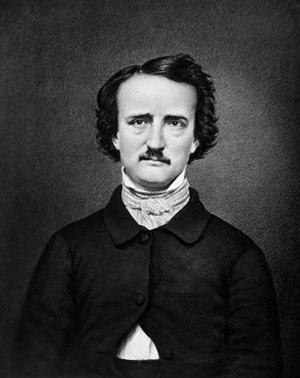
"Those who dream by day are cognizant of many things which escape those who dream only by night.“
“All that we see or seem is but a dream within a dream.”

Slide 6
Texts we will be looking at
Poems | Short Stories
The Raven | The Tell Tale Heart
Annabel Lee | The Pit and the Pendulum
The Bells | The Masque of the Red Death
A Dream Within a Dream
Eldorado

Slide 7
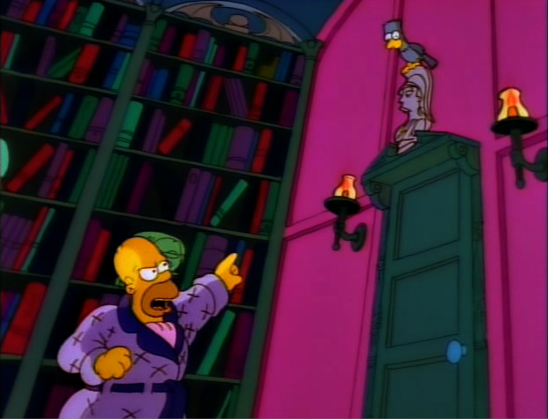
Gothicism's Influence on Pop Culture

Slide 8
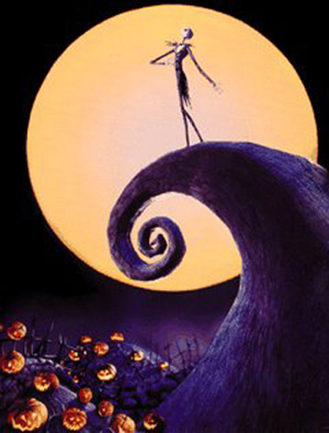

Slide 9
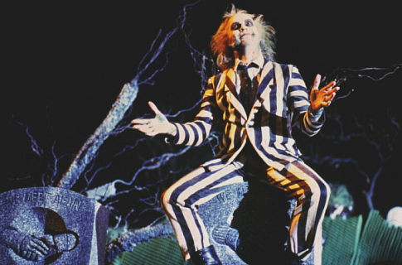

Slide 10
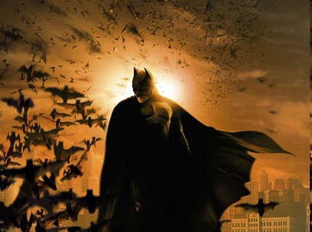

Slide 11
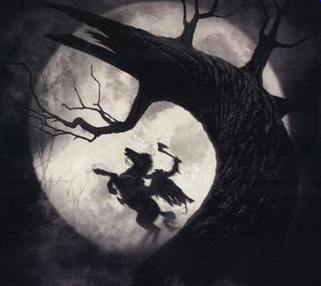

Slide 12
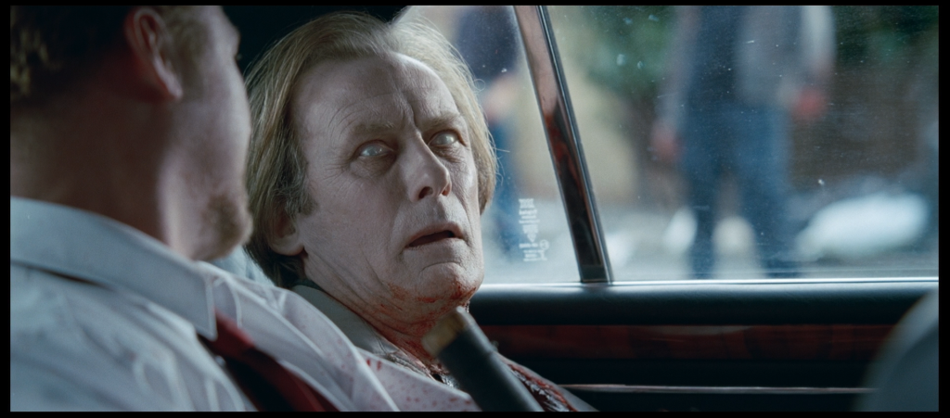
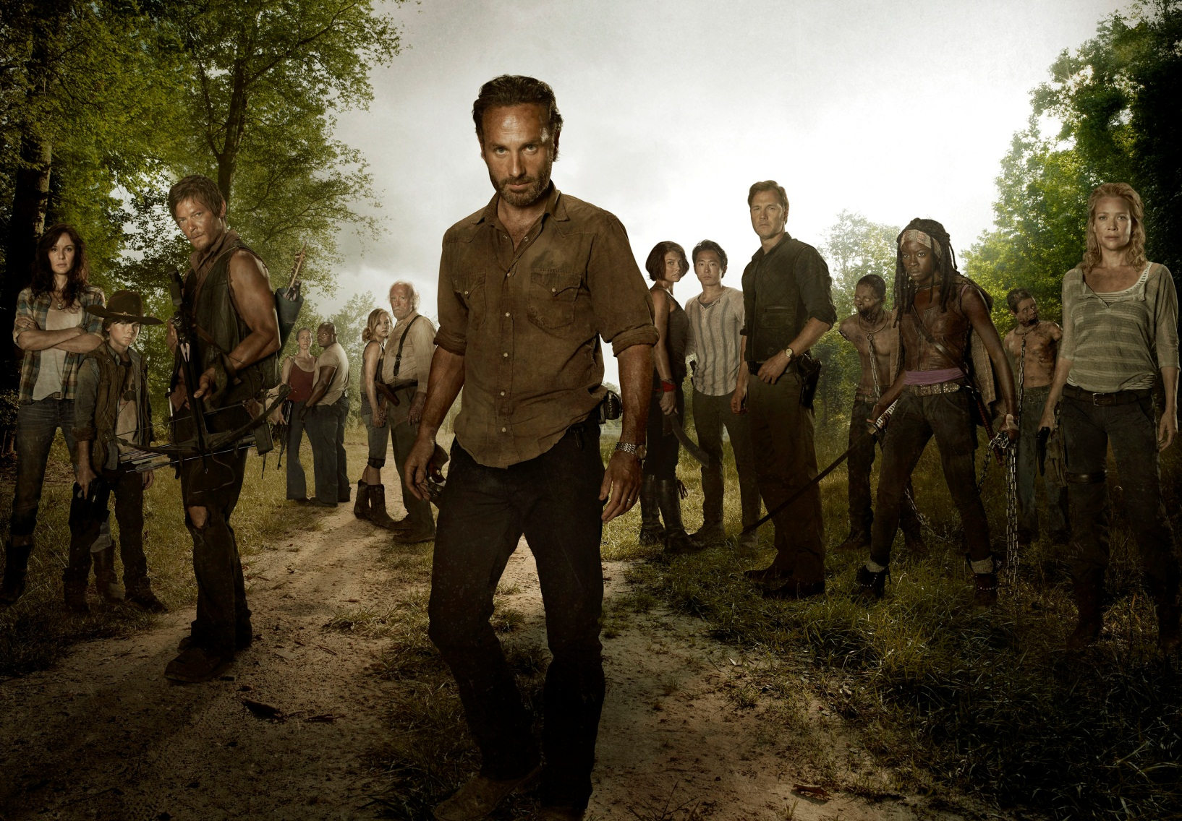
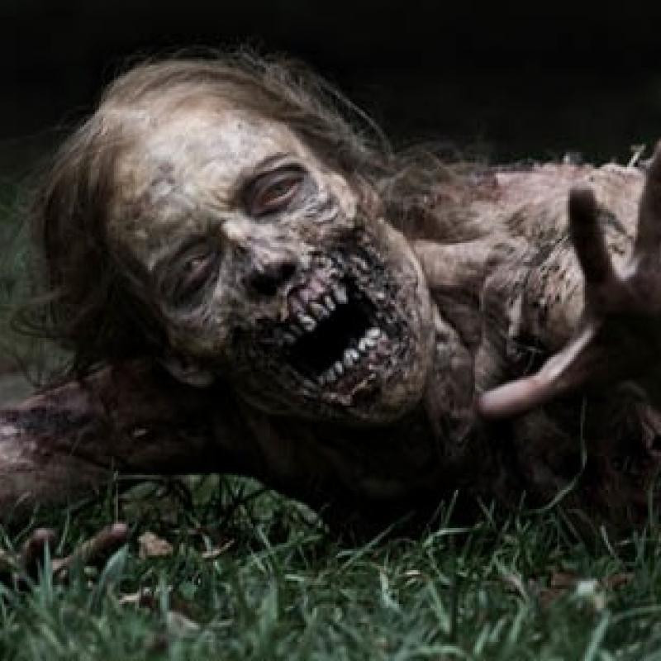

Slide 13
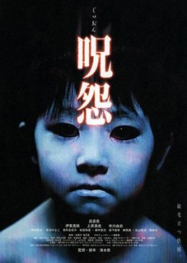
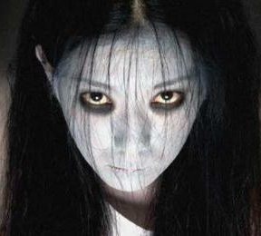

Slide 14
Faces of Gothicism

Slide 15
Edgar Alan Poe
The Raven
The Masque of the Red Death
The Tell Tale Heart
The Pit & The Pendulum
El Dorado

Slide 16
Vincent Price
Tales of Terror
The House on Haunted Hill
Madhouse
The Fly
The Last Man on Earth
Theater of Blood

Slide 17
Stephen King
Misery
Pet Semetary
It
The Stand
Carrie
The Shining

Slide 18
Tim Burton
Edward Scissorhands
The Corpse Bride
A Nightmare Before
Christmas
Sweeny Todd
Batman
Beetlejuice

