Slide 1
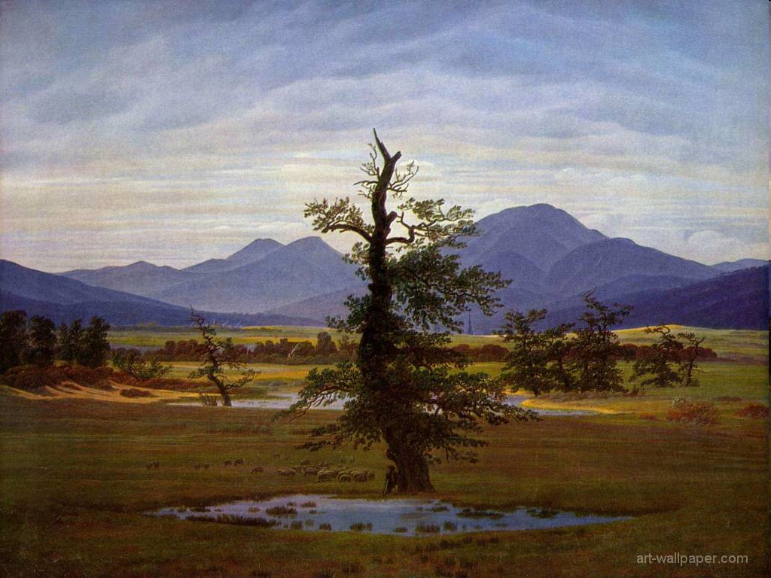
American Romanticism
1800 - 1860

Slide 2
Introduction
The theme of journey as a declaration of independence
Bryant, Holmes, Whittier, Longfellow, & Lowell are romantic poets
Irving is the father of American Literature
Cooper is the father of the American Novel
Emerson is the father of Transcendentalism
Thoreau is a famous practical transcendentalist

Slide 3
Introduction
The rationalistic view of urban life was replaced by the romantic view
Rationalists saw cities as a place to find success and self-realization
Romantics saw the city as a place of moral corruption, poverty, and death

Slide 4
Introduction
The Romantic journey is to the country side
The Romantics associated the country with independence, moral clarity, and purity
The Gothic Romantic saw the country as a place of phantasm
Irving saw the country as idyllic and as an escape

Slide 5
The Romantic Sensibility
Romanticism: values feeling and intuition over reason
Romanticism: viewing life as we would like it to be, rather than how it really is
Romanticism began in Germany and influenced literature, music, & art
Romanticism is a reaction against Rationalism

Slide 6
The Romantic Sensibility
The Development of slums and poverty due to the Industrial Revolution turned people from Rationalism
Romantics believed that imagination. Emotion, spontaneity, feelings, and nature were more important than rational thought

Slide 7
Characteristics of American Romanticism
Values feelings over reason
Values the power of the imagination
Seeks beauty of unspoiled nature
Values youthful innocence
Values individual freedom
Values lessons of the past
Finds beauty in exotic locales, the supernatural, and in the imagination
Values poetry as the highest expression of the imagination
Values myth, legend, and folk culture

Slide 8
Romantic Escapism
Romantic writing looked for comforting exotic settings from the past
This was found in the supernatural, in nature, and/or folk legends
Romantics believed in contemplating, or becoming one with the natural world

Slide 9
Romantic Escapism
Romanticism also used lyrical poetry as a means to contemplate the beauty of nature
It focused on simple natural beauties
Its intent was to seek truth through a calm contemplation of a simple natural beauty
Romantics saw God in this contemplation

Slide 10
The American Novel
Most American Romantic writers imitated the European writing style
American Romantic novelists broke away from European tradition and discovered uniquely American topics and settings
American novelists explored the vast unknown lands – something the Europeans could not

Slide 11
The American Novel
James Fennimore Cooper was the first American novelist to break away from European tradition
His novels were set in the American Frontier
His Central character, Natty Bumppo, was the first American literary hero
Bumppo appeared in a series of Cooper novels as other characters: Hawkeye, Deerslayer, Leatherstocking, etc.
His skills were almost superhuman
Cooper’s series of novels were called The Leatherstocking Tales

Slide 12
The New American Hero
American Romantic literature created this unique person
He was youthful
He was innocent
He was intuitive
He was one with nature
He was a loner – uneasy around women
He was handsome
He was brave
He was moral and honorable

Slide 13
American Romantic Poetry
Most Romantic poets worked within conventional European literary structures
They proved that American poetry could reflect American subject matter, yet still hold to conventional poetic style
Most American Romantic poets wrote about the past
The Fireside Poets, a Boston group of Longfellow, Whittier, Holmes, and Lowell, were widely read and loved in America
They were the TV of the American Romantic period and families gathered around the fireside to be entertained by their poetry
There subject matter was comfortable and instructional

