Slide 1
MLA Formatting

Slide 2
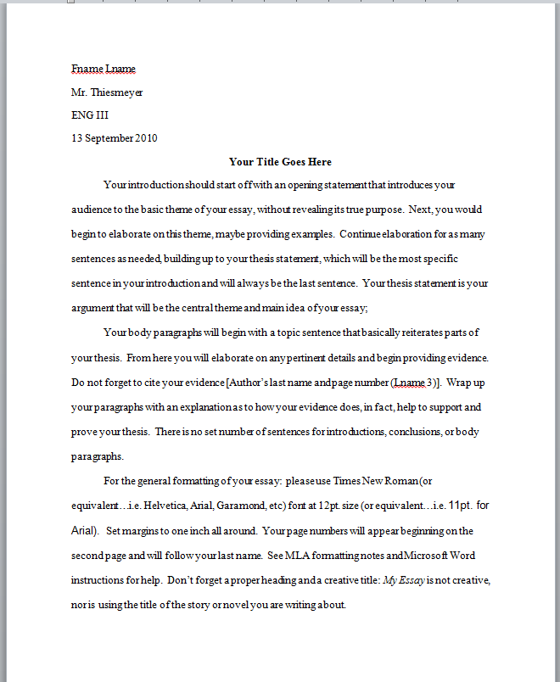
Page Layout
1”
Margins = one inch all around
Double spaced
Times New Roman or similar font*
Size = 12 pt.
1”
1”
1”

Slide 3
* Fonts
✓
✗
1”
Arial
Book Antiqua
Calibri
Garamond
Georgia
Helvetica
Tahoma
Times New Roman
Algerian
Black Adder
Bradley Hand
Comic Sans
Jokerman
Old English
Planet Benson
Stencil
1”

Slide 4
Page Layout
Indent all paragraphs
No extra spaces between paragraphs
Always put a title

Slide 5
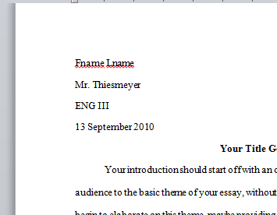
Heading
1”
Your name
Inst. Name
Course title
Date (military format)

Slide 6
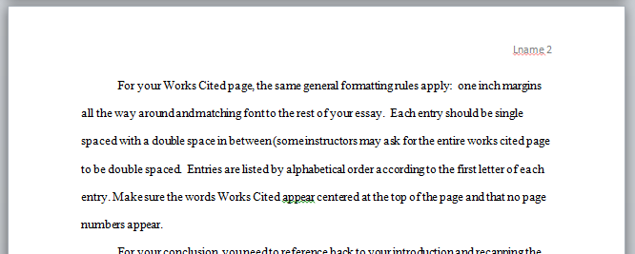
Pages beyond the first
1”
Starting on page two, write your last name followed by the pg. # in the top right corner (1/2” from the top)

Slide 7
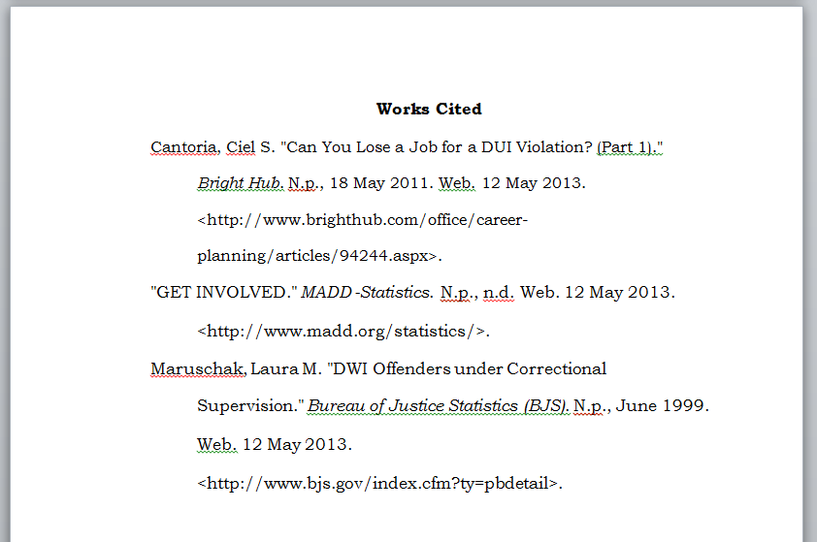
Works Cited Page
Last page
No page #
“Works Cited“ centered at top
Same margins
Double spaced
ABC order
Hanging indentions

Slide 8
MLA Formatting
Times New Roman @ 12 pt.
Double spaced
Proper MLA heading
Indent paragraphs
Always use a title
Page numbers beginning on page 2
Don’t forget parentheticals
Don’t forget your works cited page

Slide 9
Parenthetical Citation
(Chopin 2)
Parenthesis
Page #
Author’s last name

