Slide 1
The Masque of the Red Death

Slide 2
The Black Death
The Bubonic Plague

Slide 3
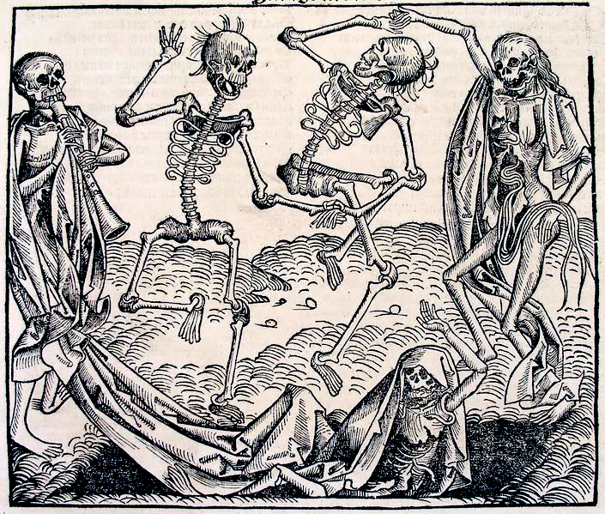
The Black Death
The Bubonic Plague (or Black Death) ravaged the European countryside beginning in the 14th century.
This disease wiped
out 30-60% of the
population.
- some say up to 75%
They don’t seem to mind too much →

Slide 4
The Rate of Expansion

Slide 5
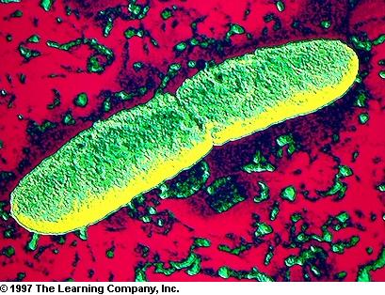
The Black Death
The Bubonic Plague is caused by a bubon bacteria
Yersinia Pestis →
The disease was
transmitted by
fleas borne on the
backs of rats that
came in on cargo ships.

Slide 6
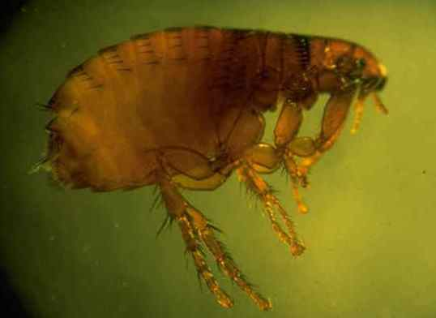
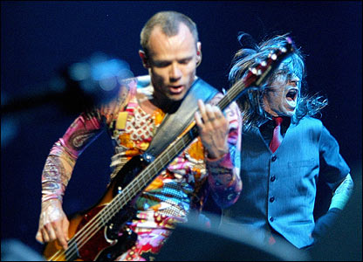
The Black Death
← This kind
Not this kind →

Slide 7
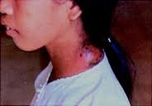
The Black Death
The disease is named the bubonic plague because of the large pustules (buboes) that would form on the skin of its victims (if a boil is a pimple on steroids, then a bubo is a boil on steroids, crack, and crystal meth).
← Gross

Slide 8
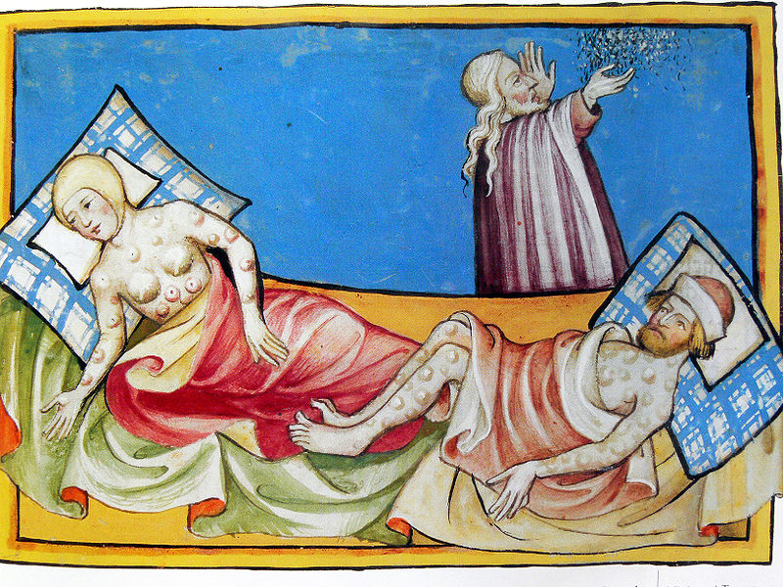
The smell must have been just awful

Slide 9
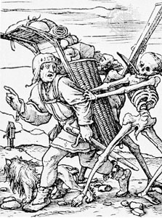
The Black Death - Characteristics
Buboes, extreme temperatures, hemorrhaging, & death
High rate of transmission
High mortality rate (again 30-60%)
Would kill in as few as 8 days
Hey, buddy…you dropped something

Slide 10
An Attempt to Avoid the Inevitable
The doctors (or death-handlers) wore distinctive robes to try to avoid the anathema
Large brimmed black hats to identify them
Thick, heavy, leather trench coat and breeches to keep infected blood off
A bird-like gas mask that had glass eyelets and a beak filled with aromatic herbs to ward of the miasmas (bad-air thought to carry plague)

Slide 11
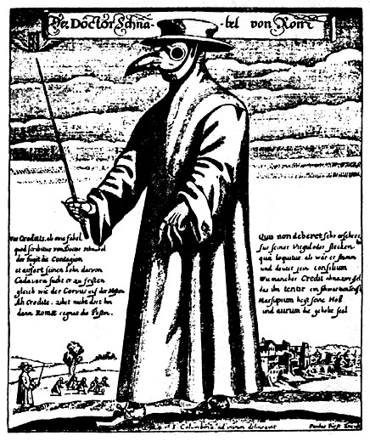
Pretty sure this was the original “chickenhead”

Slide 12
The Results
Over 35 million dead in Europe alone
Over 60 million in Asia
Caused a severe labor shortage, which lead to a demand for available labor, providing much needed jobs for the impoverished and created an environment which allowed for a rise of the middle class.
Economic prosperity and abundance of resources from death and untold misery

Slide 13
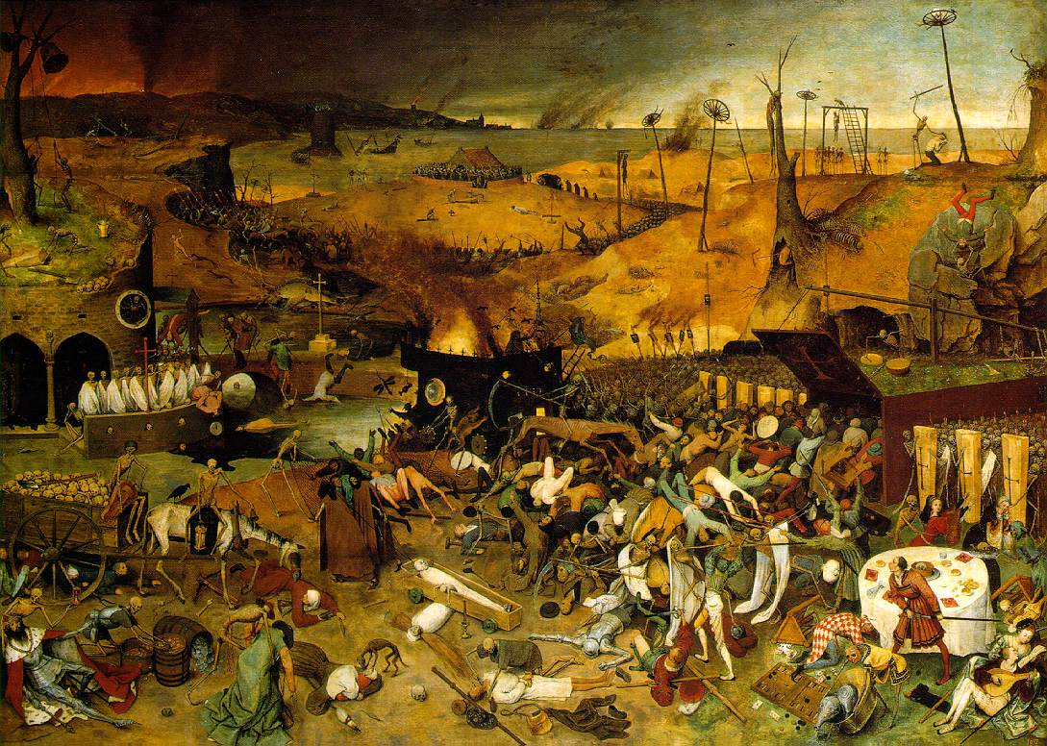
Only slightly better than a zombie apocalypse

Slide 14
A sick child’s rhyme
Ring around the rosy,
Pockets full of posies,
Ashes to Ashes,
We all fall down
People really are strange

Slide 15
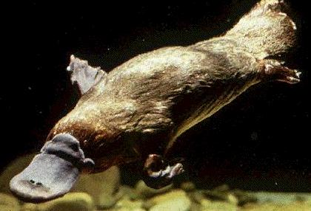
A New Plague
Not a question of if, but when!!
A new strain of influenza?
Bird flu
Swine flu
Platypus flu???
Btw, the Spanish Influenza killed more soldiers in WWI than were killed by bullets, bombs, and bayonets…combined!
A viral contagion?
C’mon…now you’re just making stuff up

Slide 16
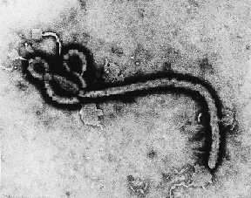
A New Plague
And the Mack-Daddy of them all…
Ebola-Zaire
From central Africa (Congo)
90% mortality rate
Kills in as little as 24 hours
Hemorrhagic fever
Chills, muscle aches, cramps
Blood fails to clot
Organs begin to shut down
Profuse bleeding through the pores
Sloughing off of soft tissues
Seizure
Death
Well, that doesn’t look too scary…uh, nevermind

Slide 17
A New Plague
It’s only a matter of time!!!

Slide 19
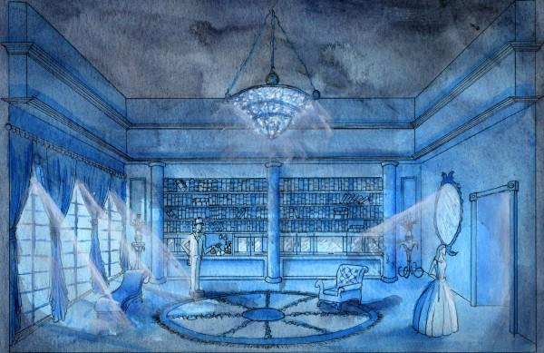

Slide 21
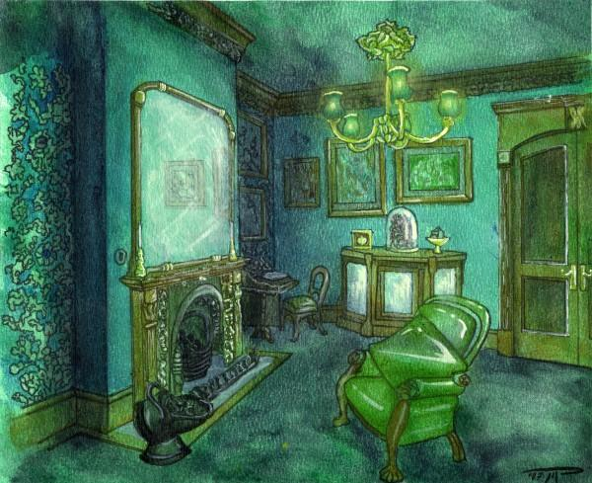

Slide 22
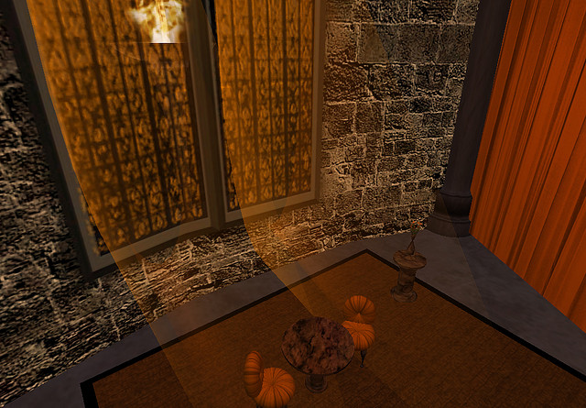

Slide 23
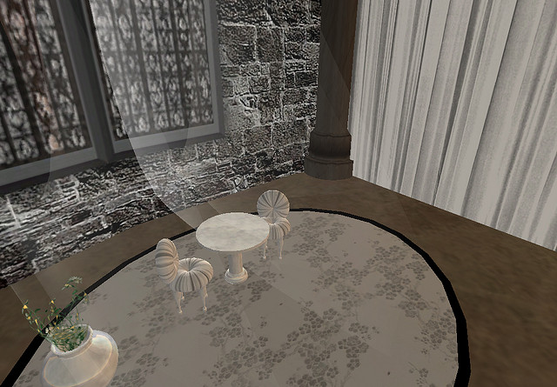

Slide 25
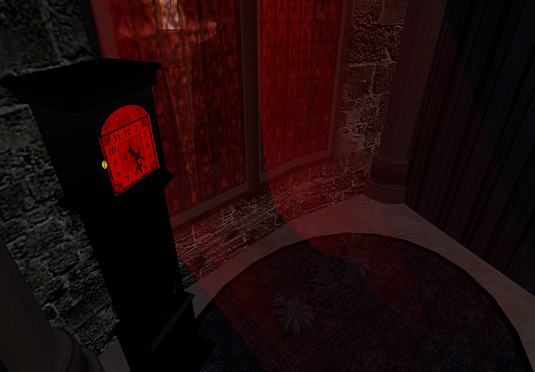

Slide 26
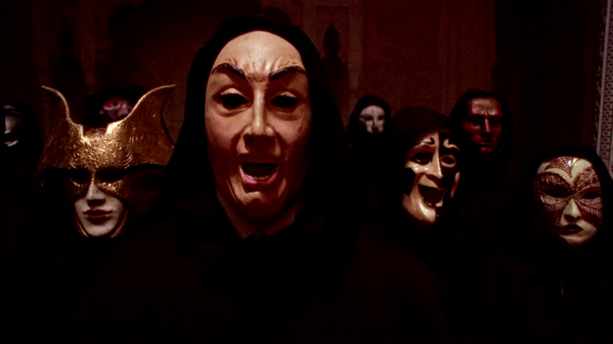
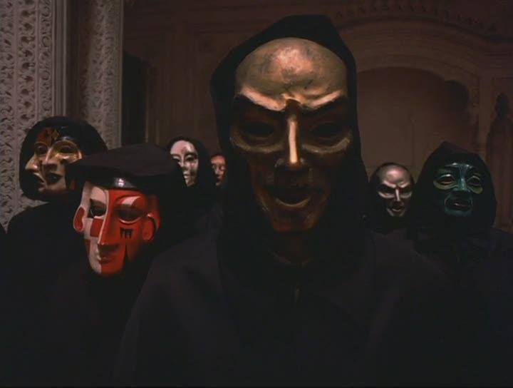

Slide 27
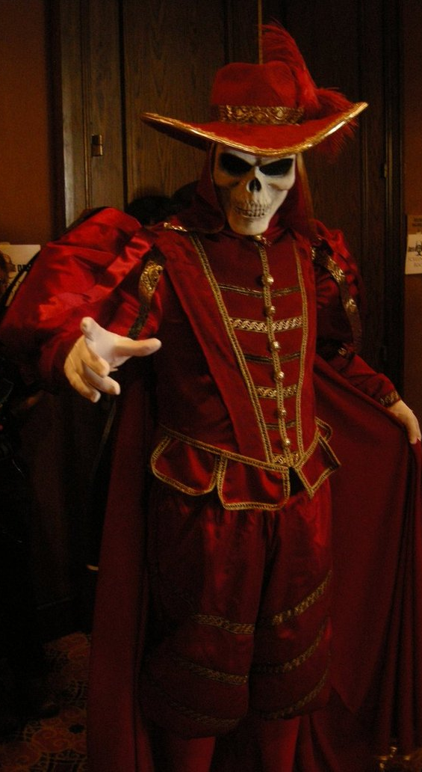

Slide 35
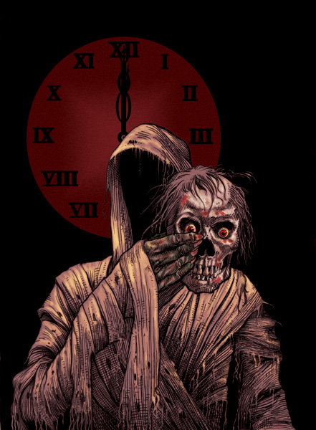

Slide 36
