Slide 1
The Spanish Inquisition
1478-1834

Slide 2
Tribunal del santo Oficio de la inquisiciÓn
The inquisition was a papal decree established to ensure the solidity of Catholic orthodoxy in the kingdoms of Spain by the monarchs Ferdinand and Isabella* in 1480
Muslim and Jewish peoples of Spain were told to convert or leave.
The Spanish Inquisition was meant to enforce this
*The same Isabella that Port Isabel and the Queen Isabella Causeway are named after

Slide 3
Inquisition – N. A period of prolonged and intense questioning and interrogation
Inquisitors were sent out determine if converted Jews and Muslims really were “keeping the faith”
Also, they were to seek out protestants and those deemed heretics*
The inquisition process determined to obtain “confessions” of heresy by any means necessary**.
* Heretic – N. Any person who believed or acted in a way contradictory to the established or orthodox religion (in this case, the Catholic Church)
** Torture was not rampant, but was by no means absent from practice.

Slide 4
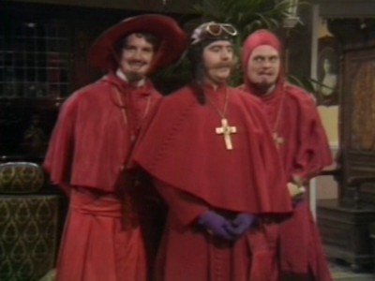
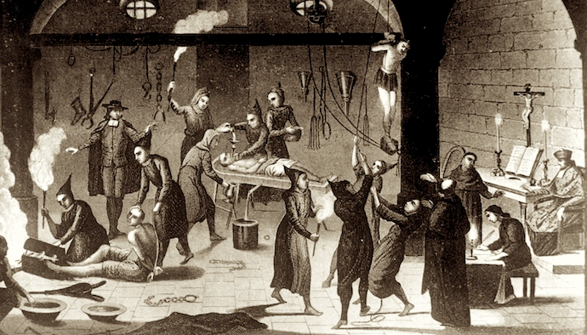
The Inquisitors
These guys don’t look too threatening
…oh, that’s more like it.

Slide 5
Torture – Eliciting a Confession
Some of the methods of extracting a confession:
Porto or The Rack
Strapaddo or Garrucha
Garrote
Interrogatorio mejorado del aqua or Toca

Slide 6
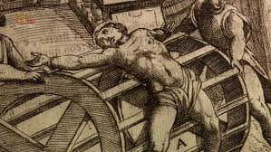
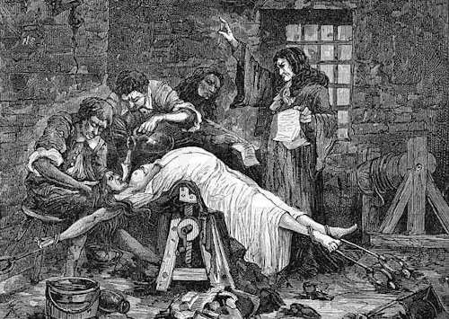
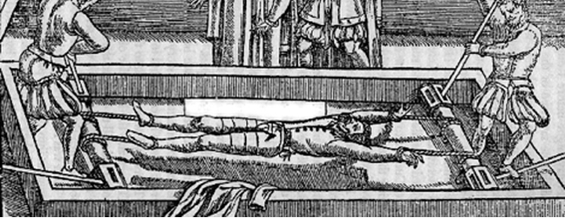
The Porto or The Rack
The Porto or Rack was a means of “stretching” a confession out of a person.
The radial method
Combination of porto and toca
Well, I did stay at a Holiday Inn Express

Slide 7
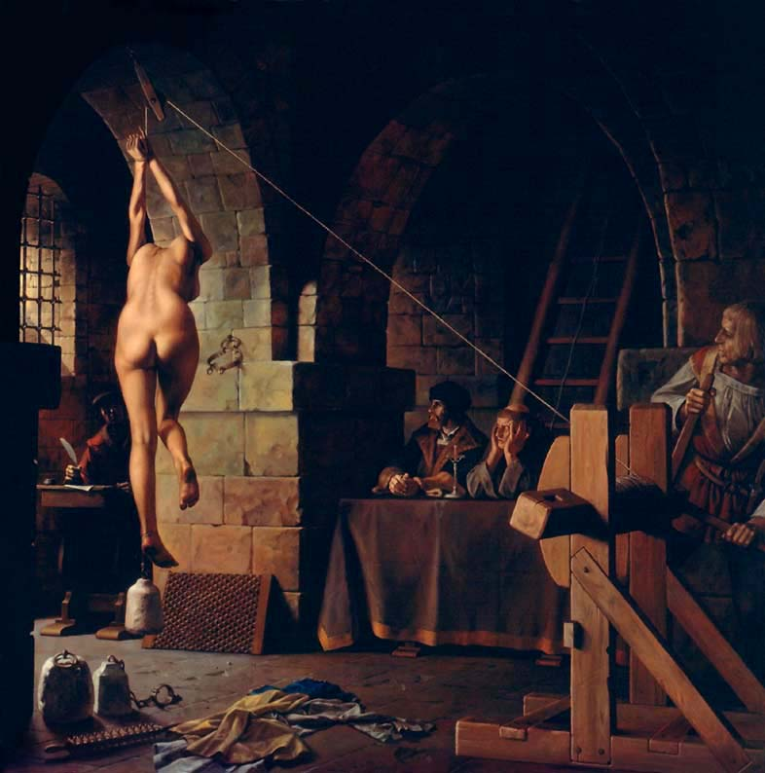
The Strapaddo or Grarrucha
Commonly used and highly effective means of torture
Hands bound behind the back and hoisted off the ground
Frequently bounced to enhance torture
Yes, that is a large weight attached to the foot

Slide 8
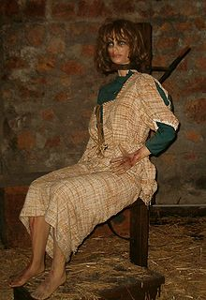
Garrote
Used on those who confessed as a means of mercy
Wire or fabric looped around neck, twisted, & tightened until the neck pops
Ye olde chiropractor

Slide 9
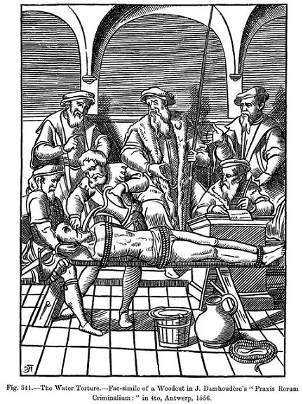
Interrogatorio Mejorado del Agua or Toca …………….
Otherwise known as water torture or waterboarding
Usually performed by placing a cloth over the victim’s face or down the throat and then pouring water on the rag to simulate drowning.
Highly effective – so much so that it is still used by the CIA and special forces
Dick Cheney would approve

Slide 10
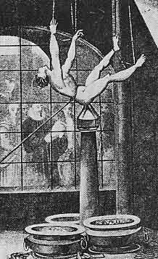
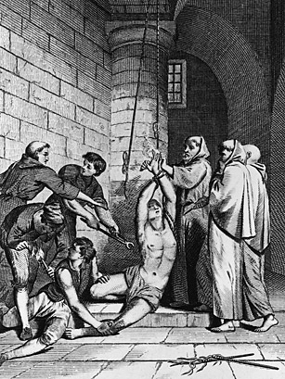
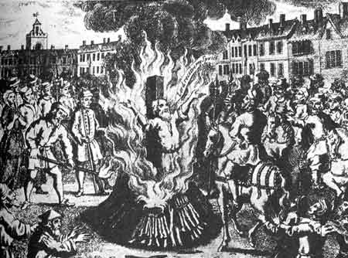
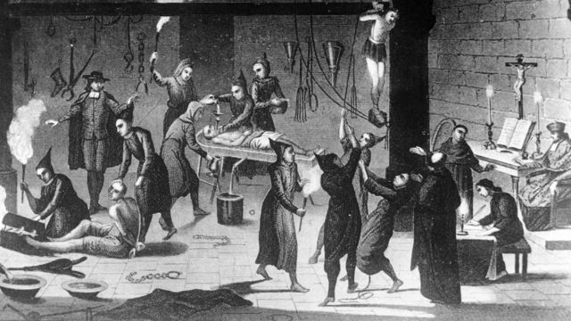
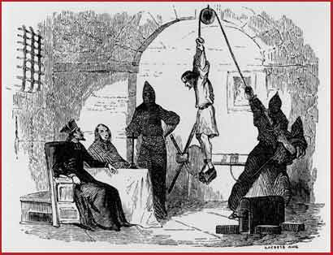

Slide 11
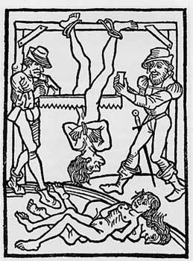
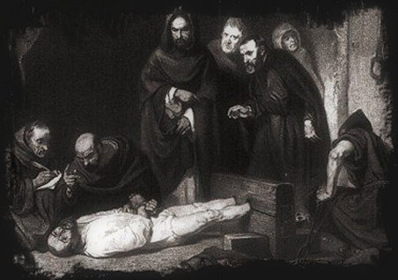
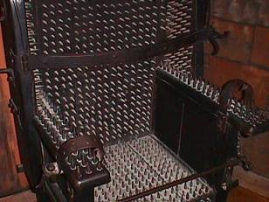
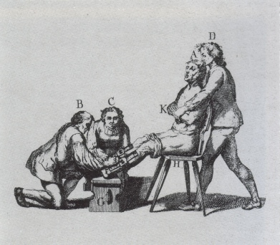
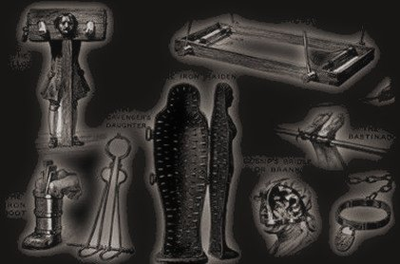

Slide 12
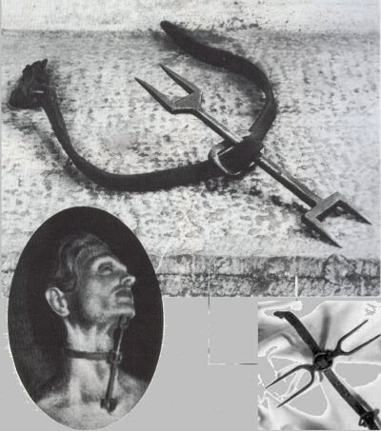
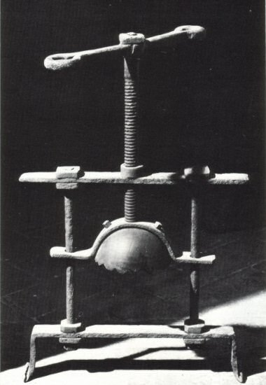
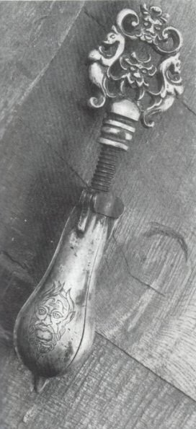
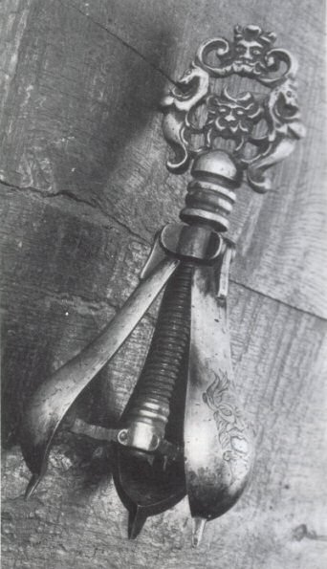
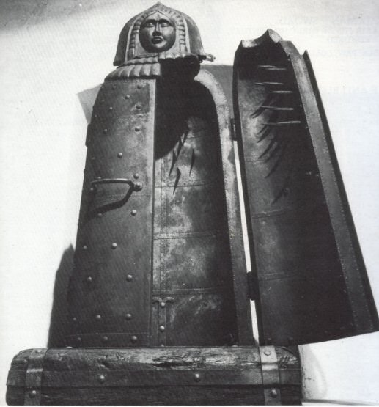
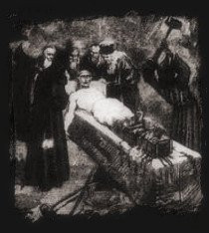
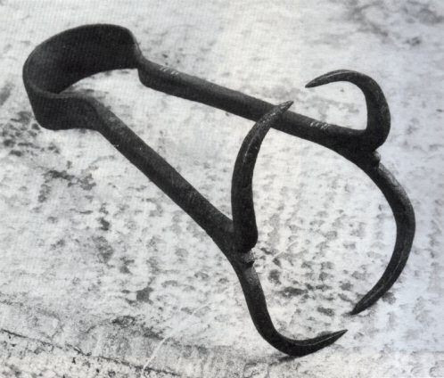

Slide 13
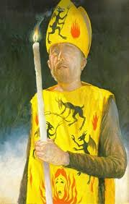
The Auto-da-FÉ
A public trial where the accused would be allowed to confess their heresies.
Accused would don a special garment that would indicate fate

Slide 14
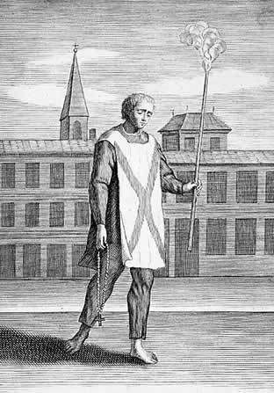
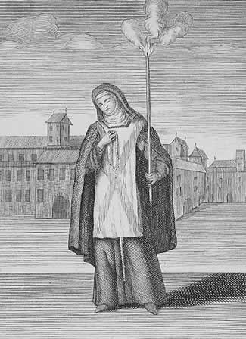
THOSE WHO CONFESSED BEFORE THE TRIAL WORE THE SAN BENITO

Slide 15
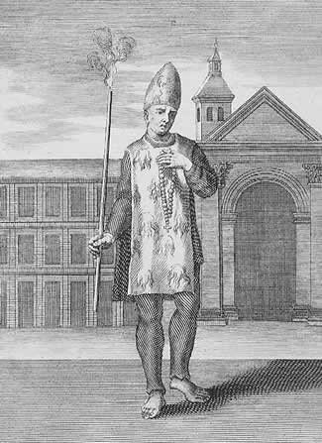
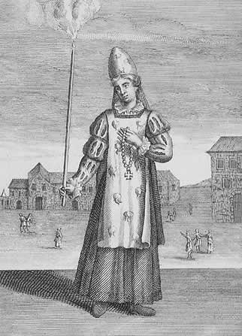
THOSE WHO CONFESSED AFTER THEY WERE CONDEMNED WORE THE FUEGO REVOLTO

Slide 16
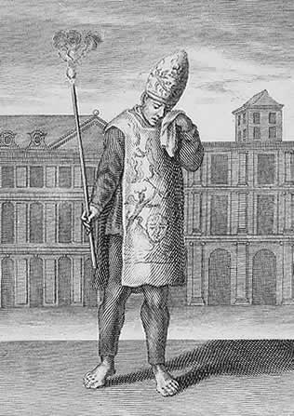
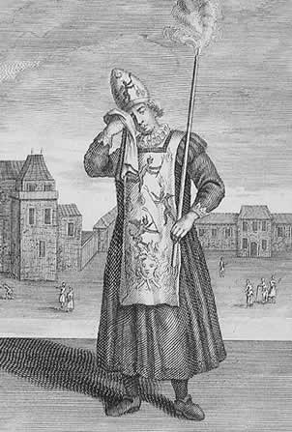
THOSE CONDEMNED TO DEATH BY BURNING WORE THE SAMARRA

Slide 17
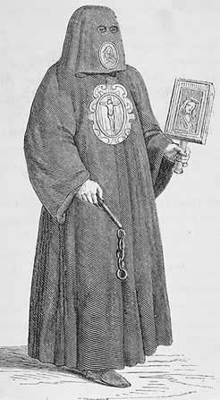
Member of the "Brotherhood of Death" Who Escorted the Condemned to the Stake

