Slide 1
Writing Workshop # 3
Persuasive Essay
Domestic Troubles

Slide 2
Step # 2 – Formulate Thesis
Step # 1 – Pick a Topic
Choose a topic that you care about and pick a side.
In one sentence, state your topic and position.

Slide 3
Step # 3 – Begin Research
Find out a little about your topic:
What caused/started it?
Why is it an issue?
Where are things headed?
REMEMBER to record where you get your information!!!

Slide 4
Step # 4 – Cont. Research
Whenever you find a source you want to use, get your works cited info first so you don’t have to hunt it down again later.
Use easybib.com

Slide 5
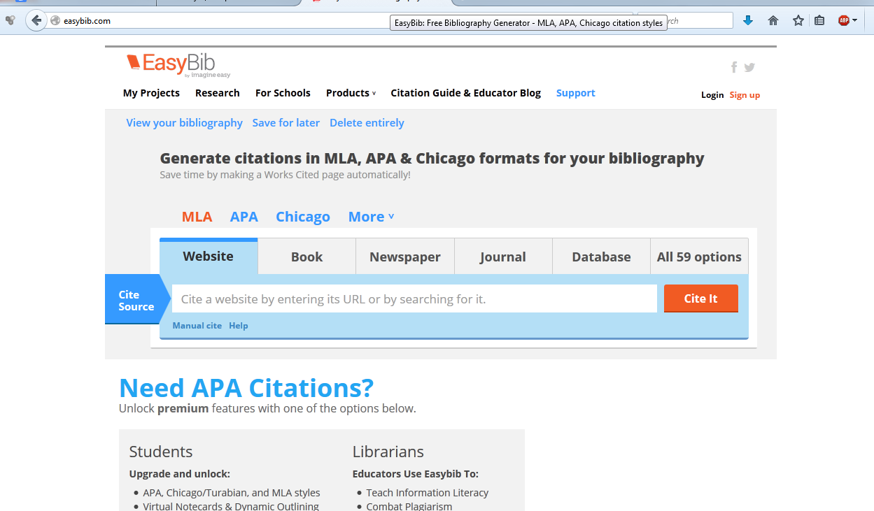
Step # 4.1 – Easybib.com
Go to easybib.com ⬇ (best to have open in separate tab)

Slide 6
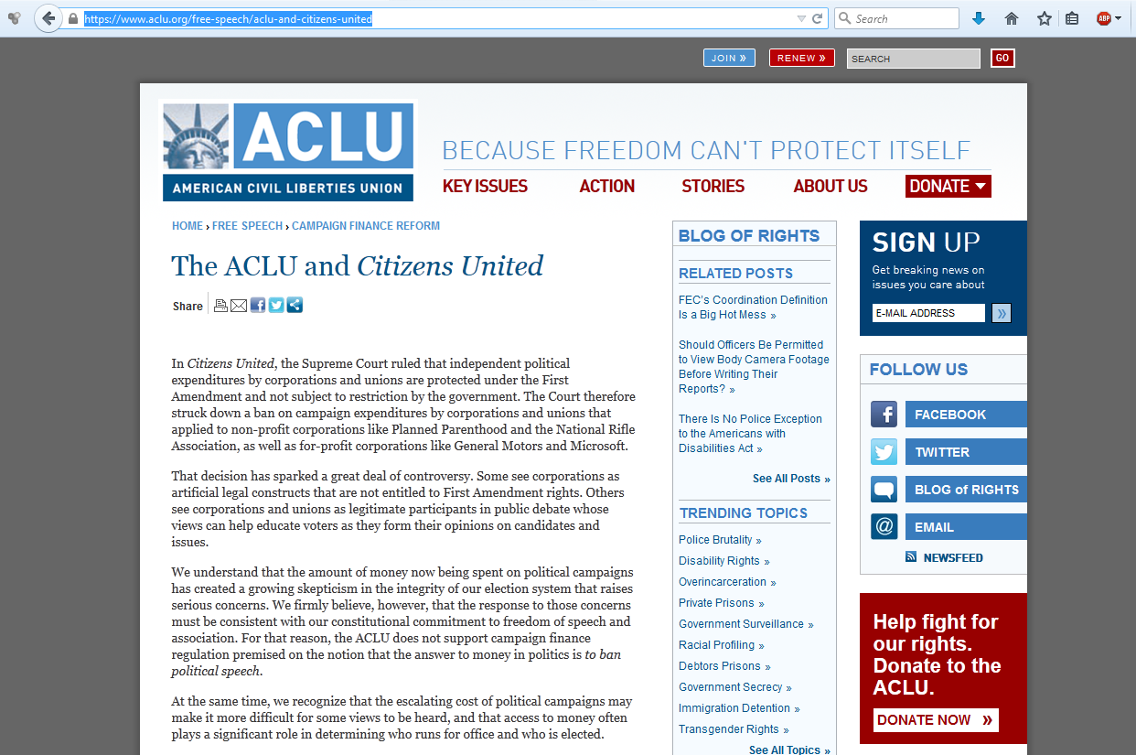
Step # 4.2 – Easybib.com
When you find a site you want to use, copy the URL

Slide 7
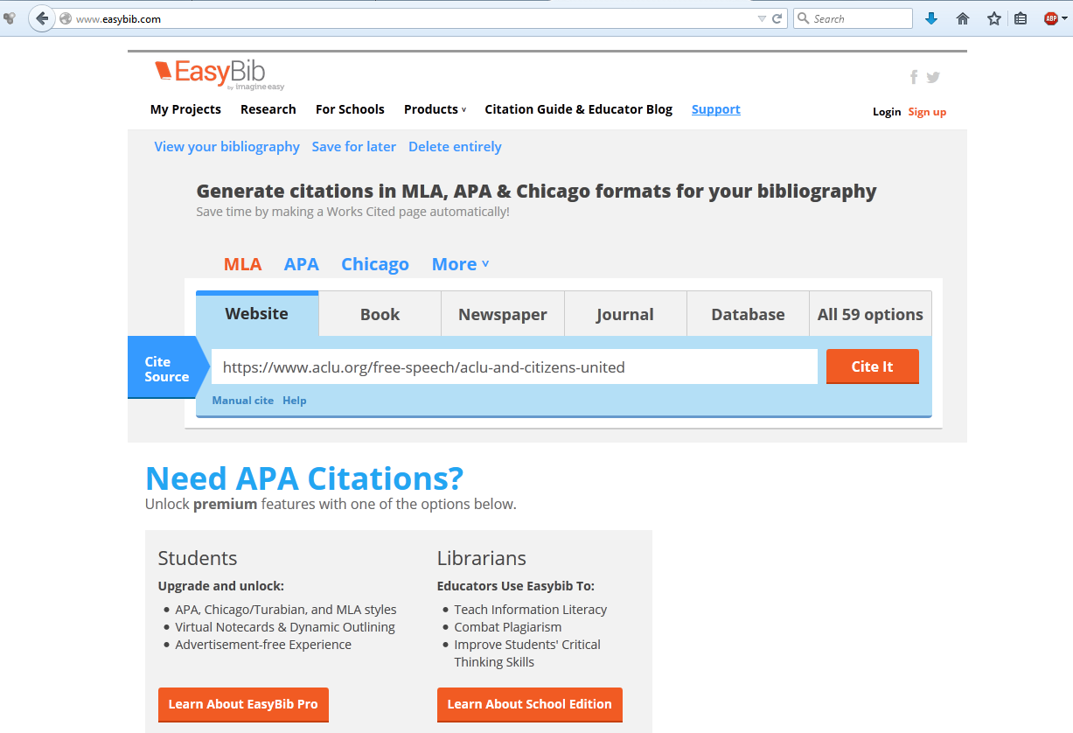
Step # 4.3 – Easybib.com
Paste URL here and click Cite It

Slide 8
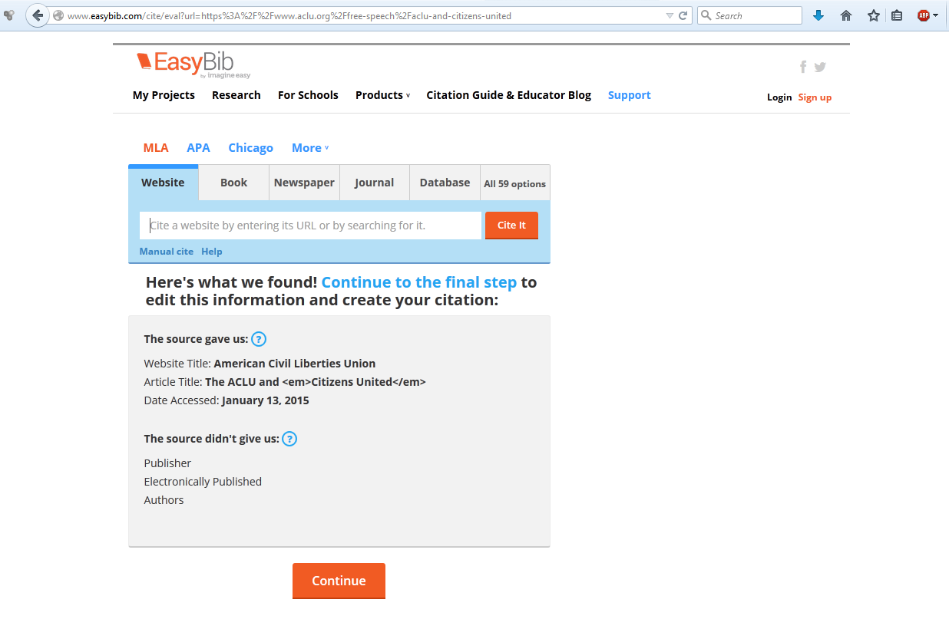
Step # 4.4 – Easybib.com
Click Continue

Slide 9
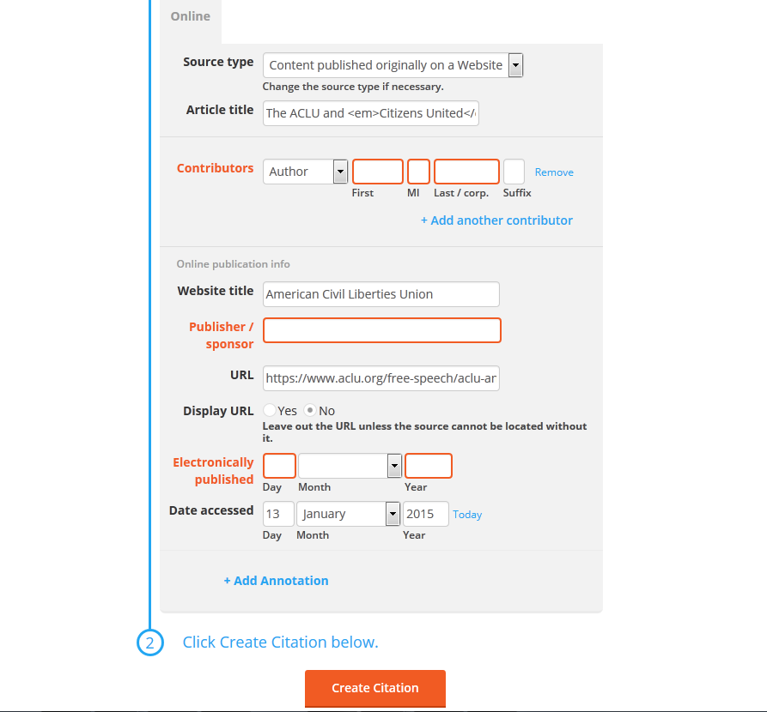
Step # 4.5 – Easybib.com
Add missing information if available.
Click Yes to display URL
Then, click Create Citation

Slide 10
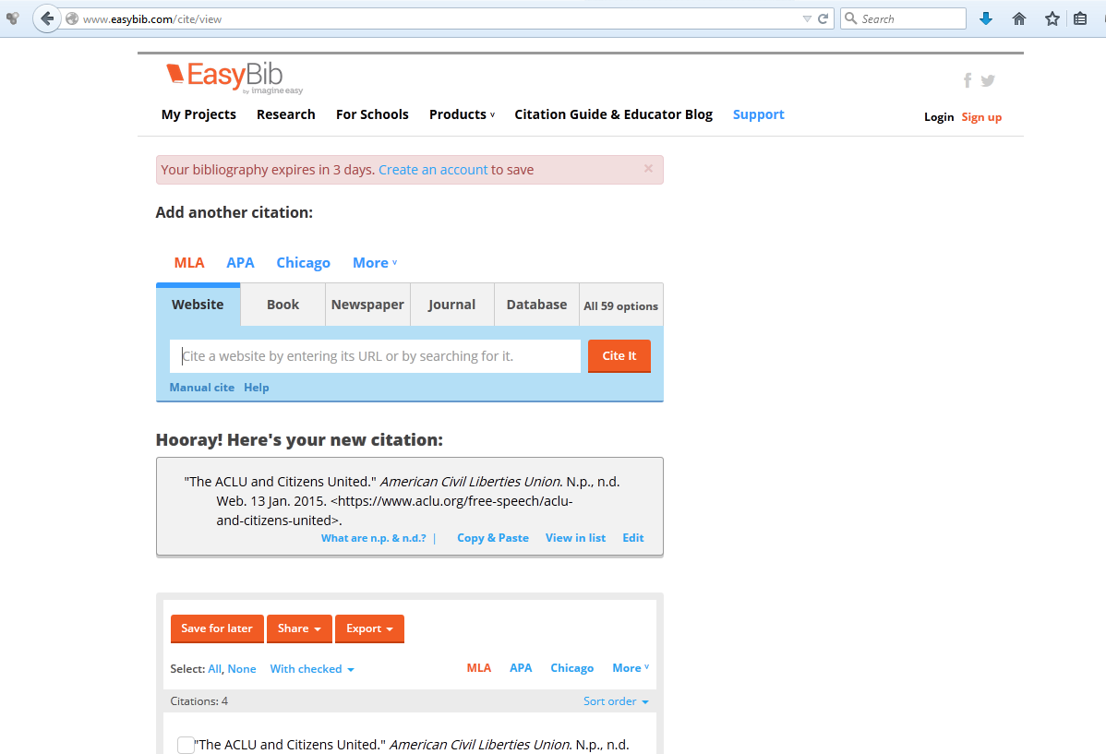
Step # 4.6 – Easybib.com
Copy/paste citation to MS Word & save

Slide 11
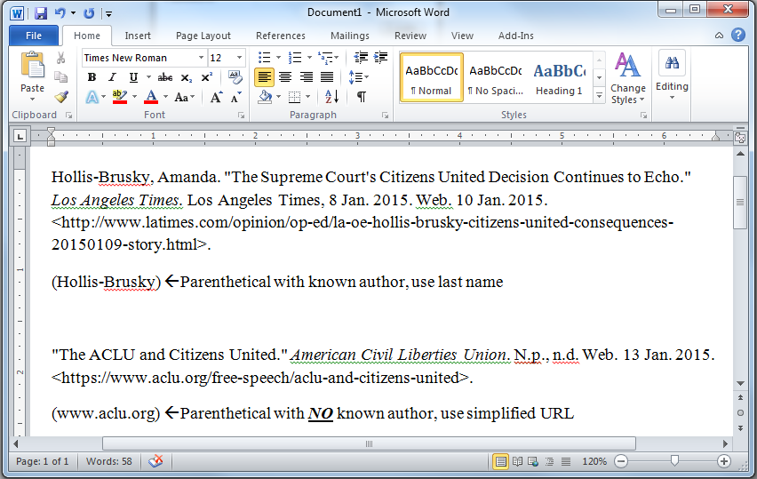
Step # 5 – Parentheticals
A parenthetical goes after each quote or specific info you got from a source – tells your reader where you got your info

Slide 12
Step # 6 – Time to Write
Specific thesis (list):
________ is the worst problem because reason 1, reason 2, and reason 3.
Reason 1 → #1
Reason 2 → #2
Reason 3 → #3
OR

Slide 13
Step # 6 – Time to Write
2. Non-specific thesis (no list):
________ is the worst problem.
ex. Description of problem →#1
ex. Why it’s so bad → #2
ex. What happens if nothing changes → #3

Slide 14
Step # 7 – Introductions
Use Funnel Method
General → Specific
Blanket statement: we’ve got problems
Elaboration: examples
Thesis

Slide 15
Step # 8 – Body Paragraphs
Separate paragraph for each idea
Use the modes of rhetoric
Logos – facts and details
Ethos – your information comes from trustworthy sources
Pathos – emotional appeal to gain support for your position
Cite your sources – after quotes or info, use a parenthetical

Slide 16
Step # 8 – Body Paragraphs
Topic Sentence
|
|
Facts & Information + analysis
(how does the info relate?)
|
|
Transition

Slide 17
Step # 9 – Conclusions
NO FORMULA
Good place for pathos
No new info
Recap
Restate thesis
Final chance to drive point home

Slide 18
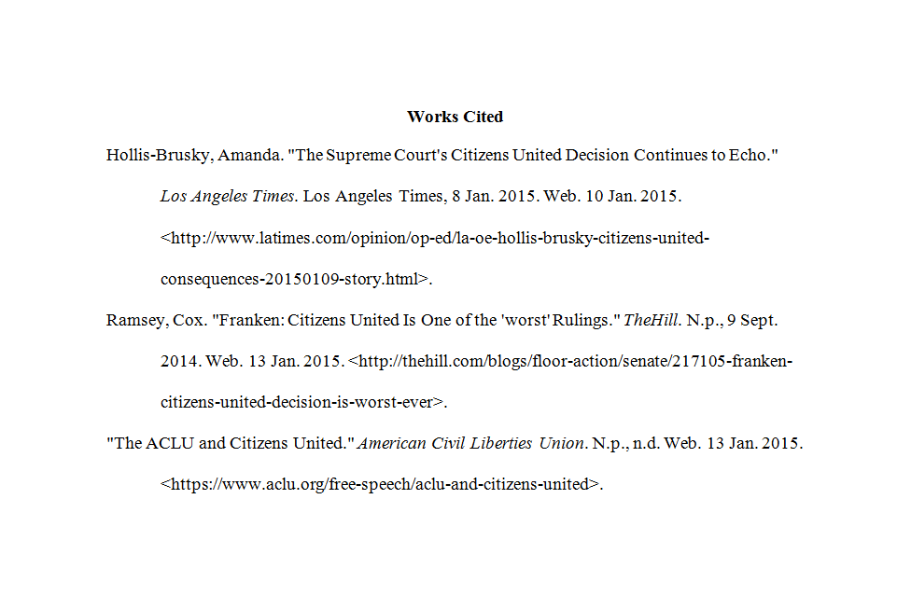
Step # 10 – Works Cited Page
On a separate page (ctrl + enter = page break)
Works Cited centered at top
Entries in alphabetical order / hanging indention

Slide 19
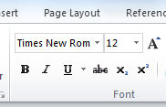
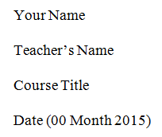
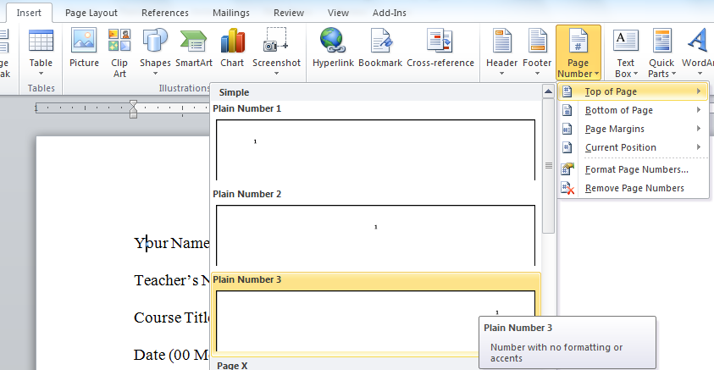
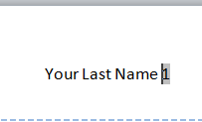
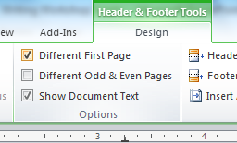
Step # 11 – MLA Formatting
Times New Roman 12pt
Double Spaced
Proper Heading
Add a title
Indent paragraphs
Page #s starting on page 2

