Slide 1
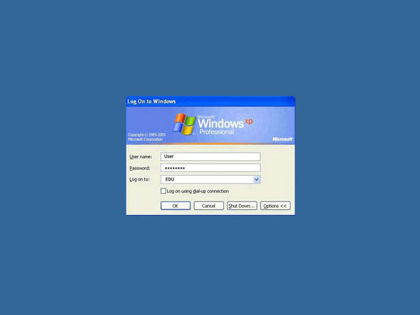
Getting Started

Slide 2
LOG into computer using:
4 first letters of last name
3 first letters of first name
4 last digits of your id #
Sample:
Albert Einstein 80012345
Einstein Albert 0012345
Username: einsalb2345
Password: lfhs001

Slide 3
Change your password to something you can easily remember!!!
This username & password will be the same that you use to connect to the LFHS wifi network

Slide 4
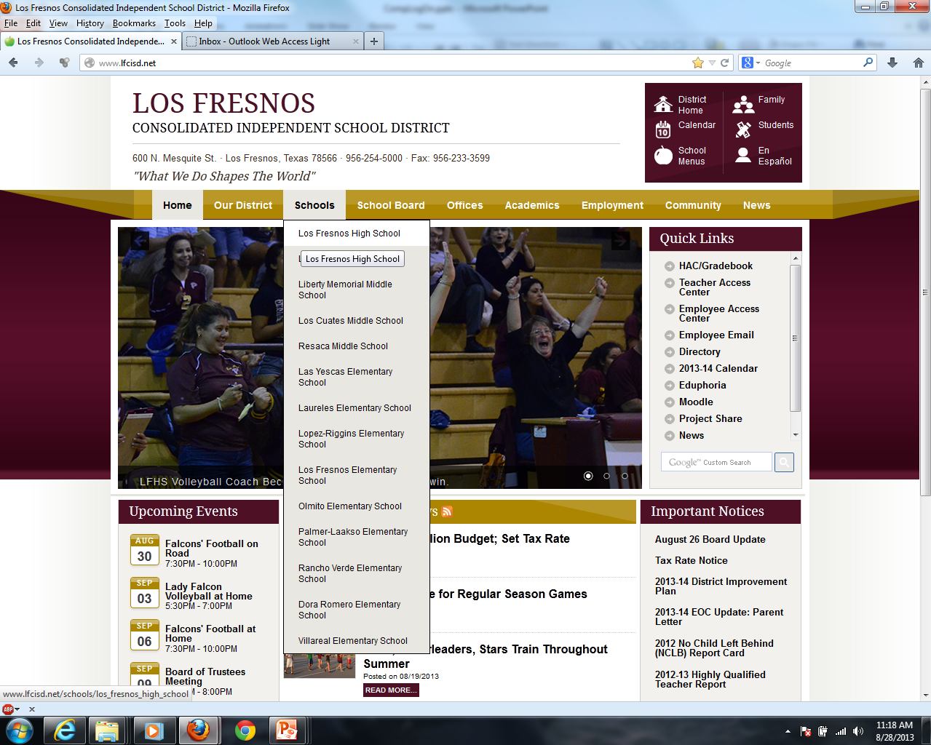

Slide 5
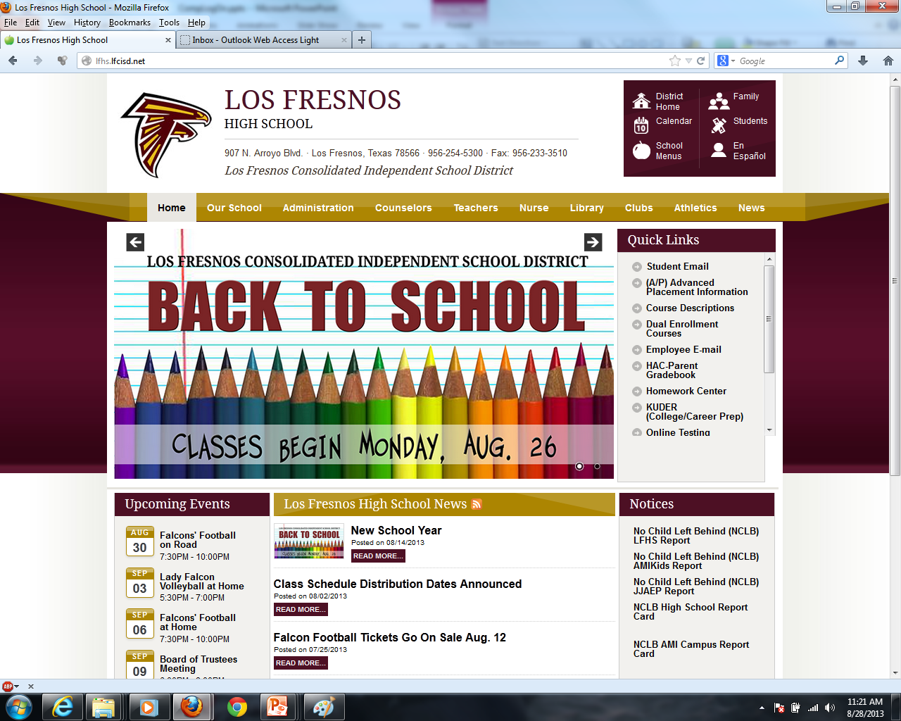

Slide 6
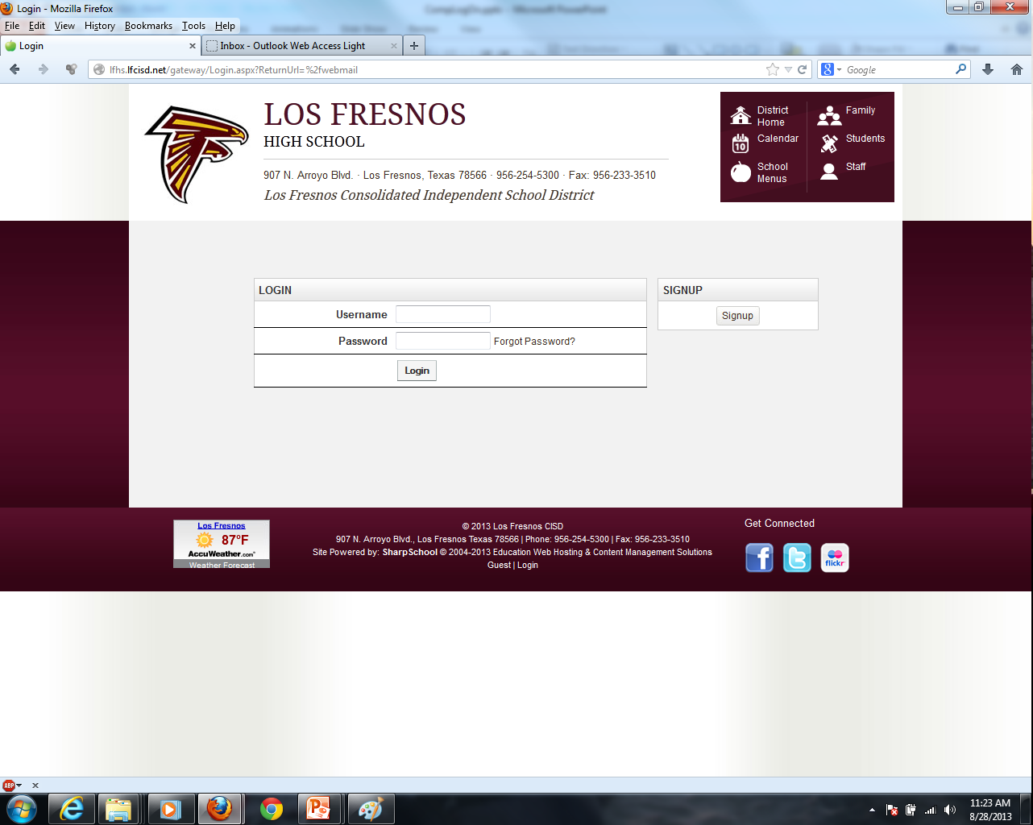
Use the same Username & Password that you used to log into the computer
Your email will be username@student.lfcisd.net

Slide 7
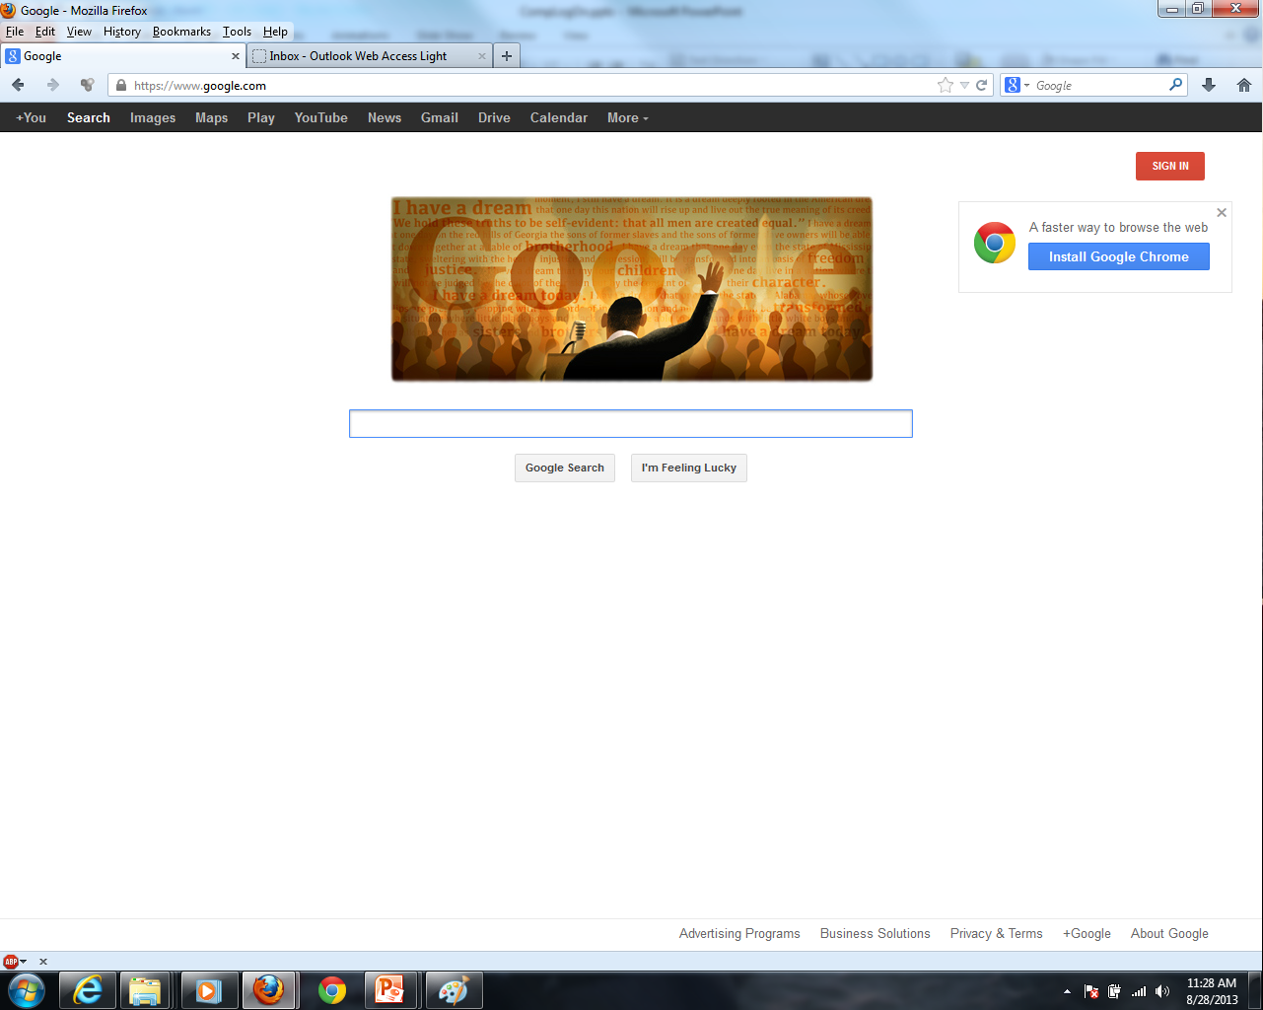
You may have to click on “More” to see the “Drive” link

Slide 8
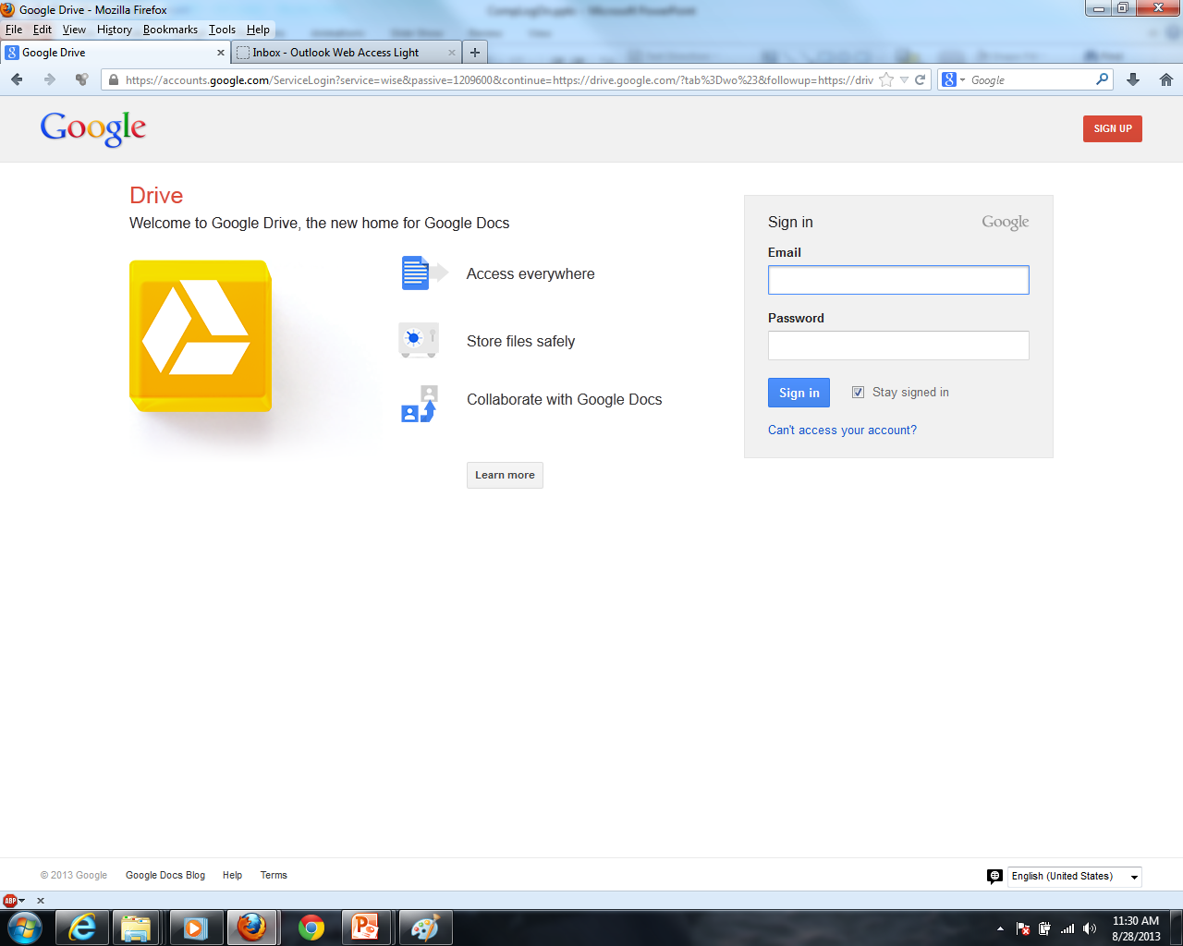

Slide 9
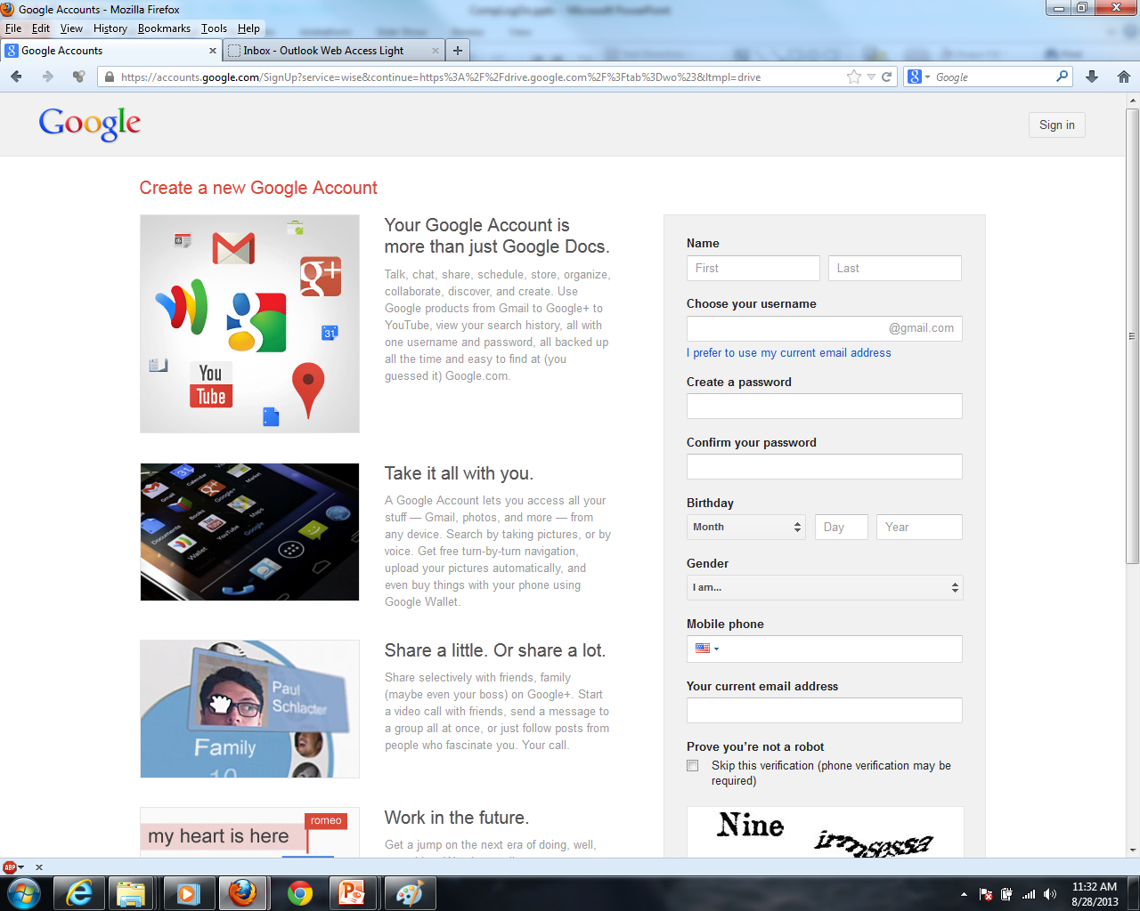
You will be using your school email for this

Slide 10
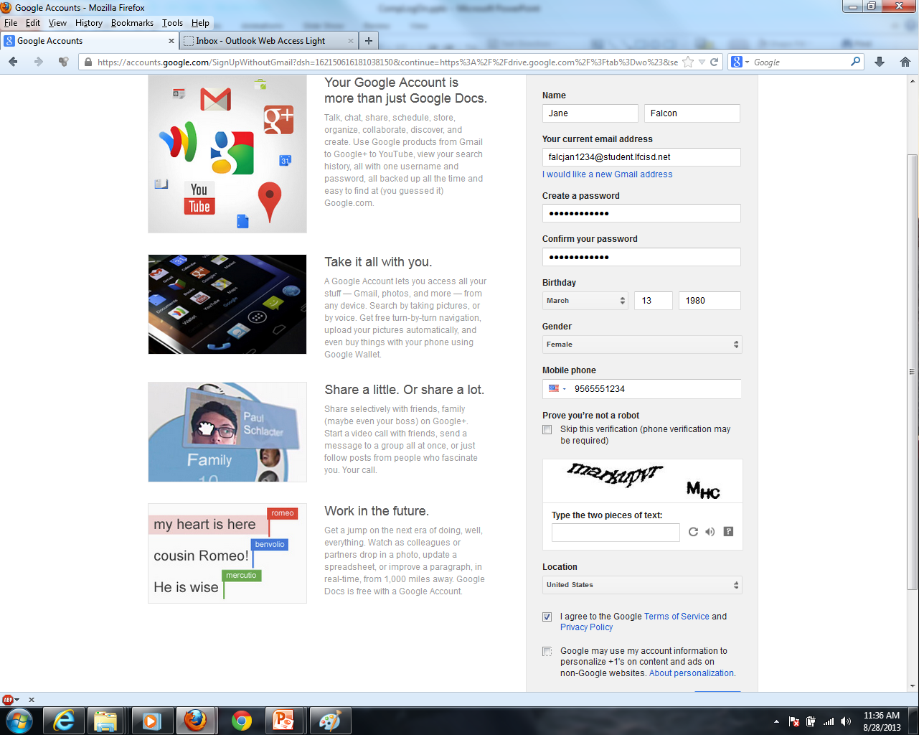
Use the same password!!!
Use your cell #
Enter Captcha
Select
Deselect

Slide 11
You will have to confirm your account through your phone (text) and your email (school)

Slide 12
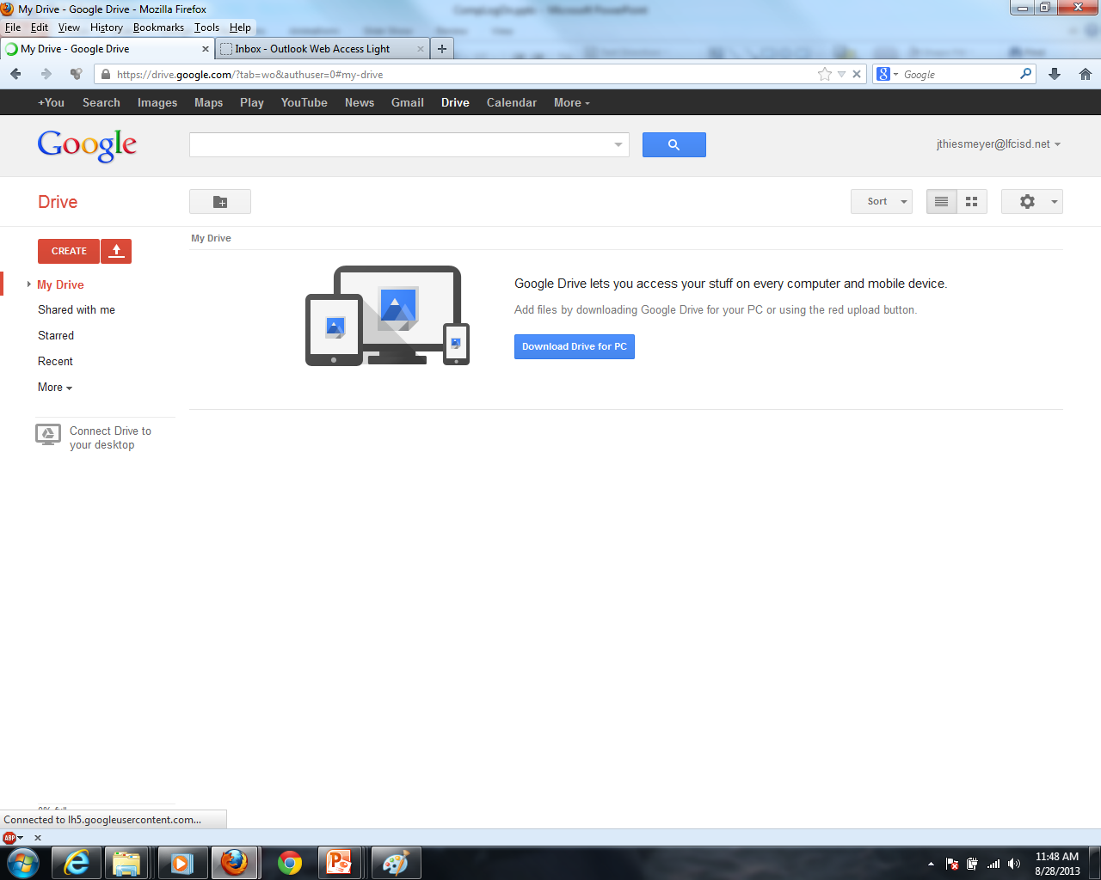
Google Drive welcome page

Slide 13
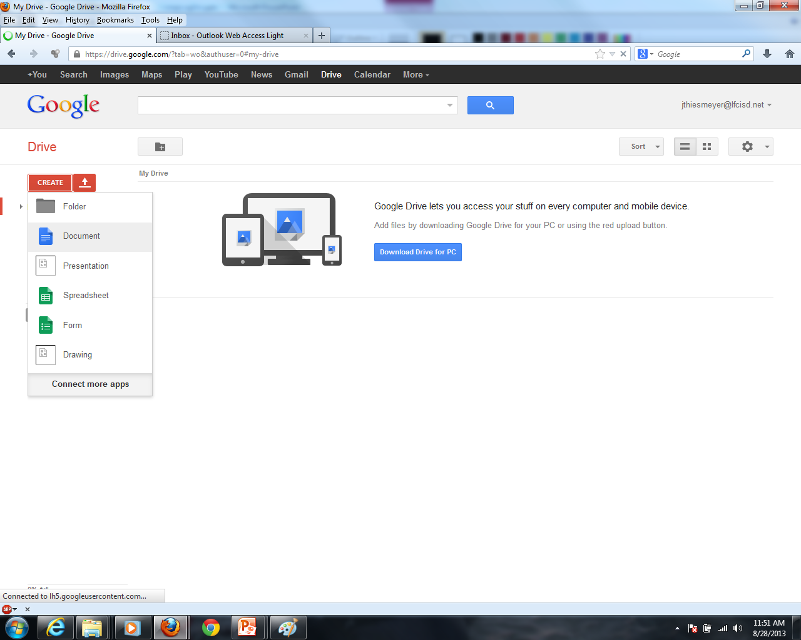

Slide 14
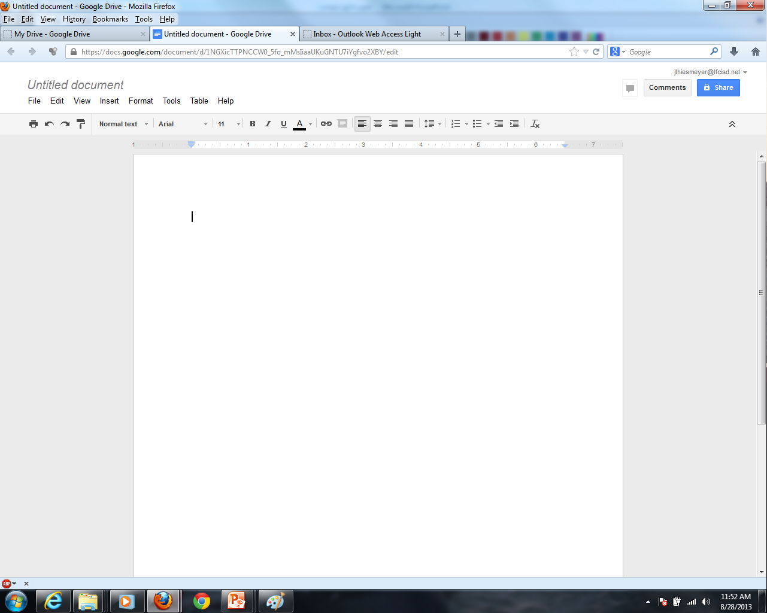

Slide 15
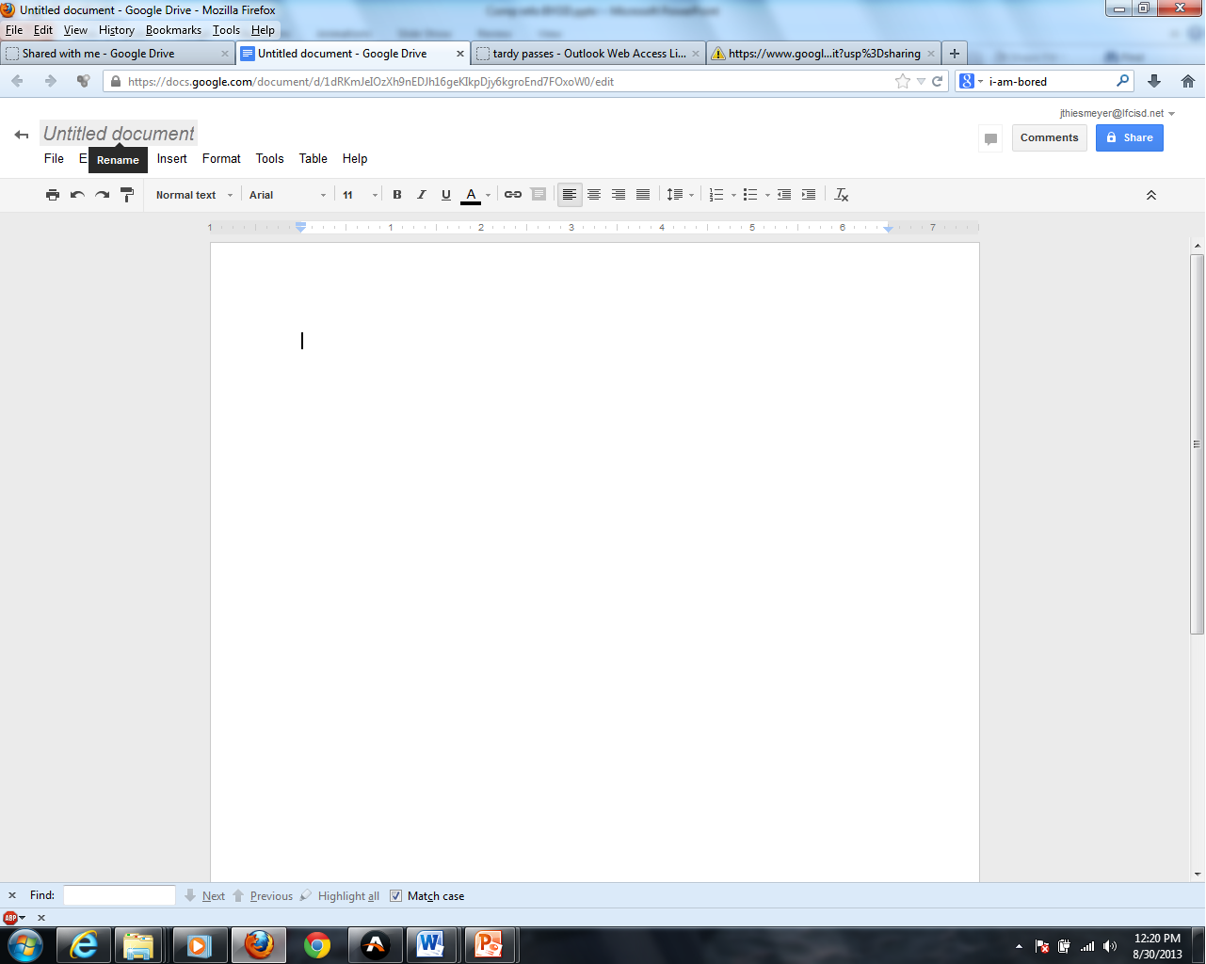
Click to retitle

Slide 16
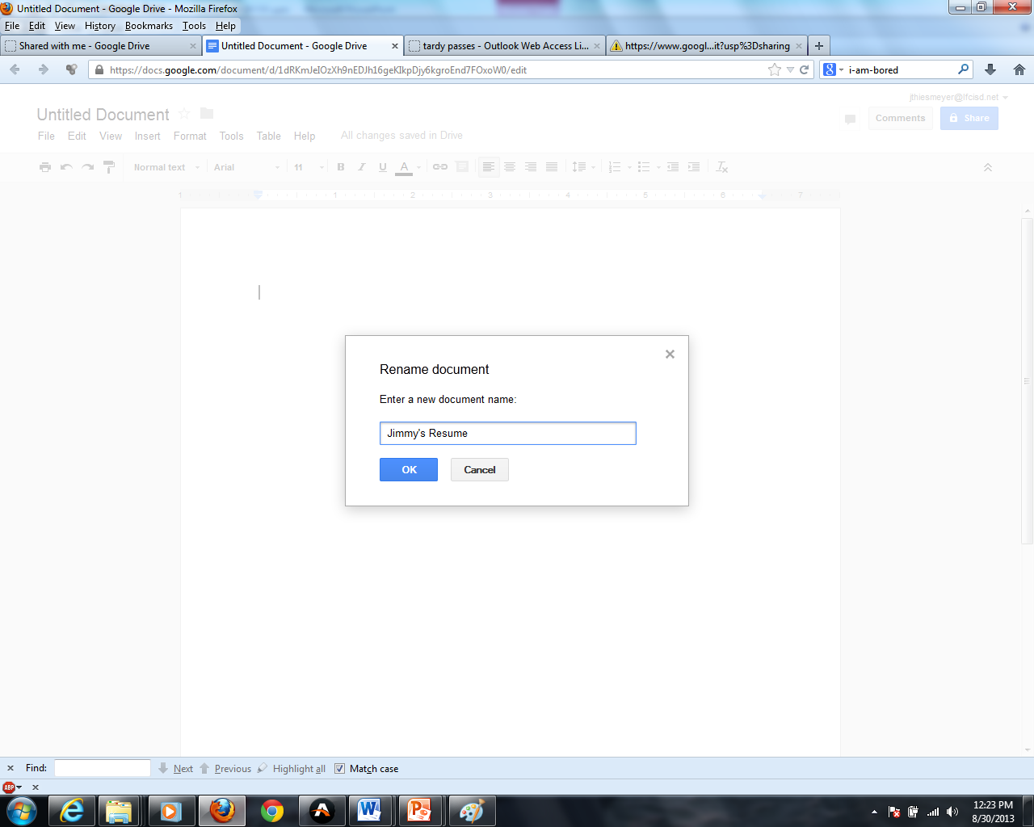
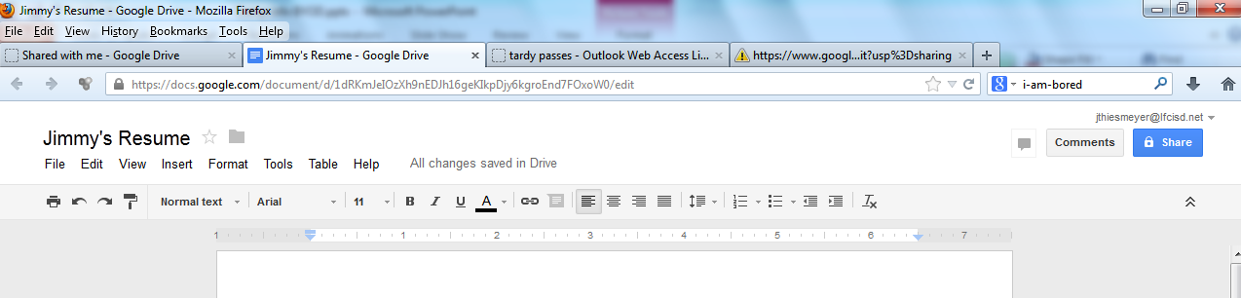
Enter title

Slide 17
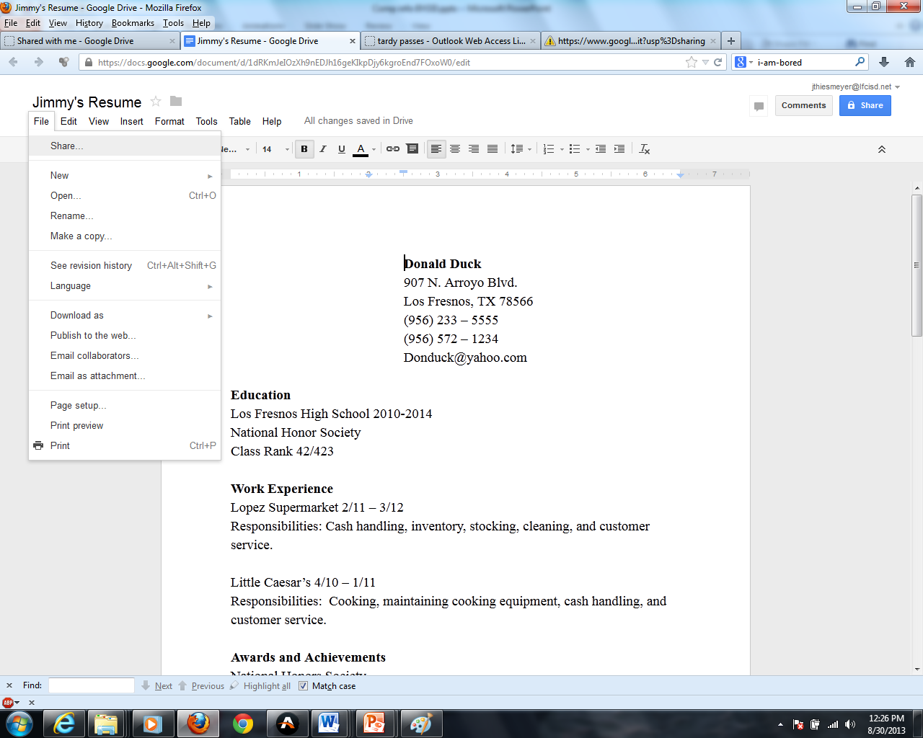
All info is auto-saved with every keystroke
Click here to share file

Slide 18
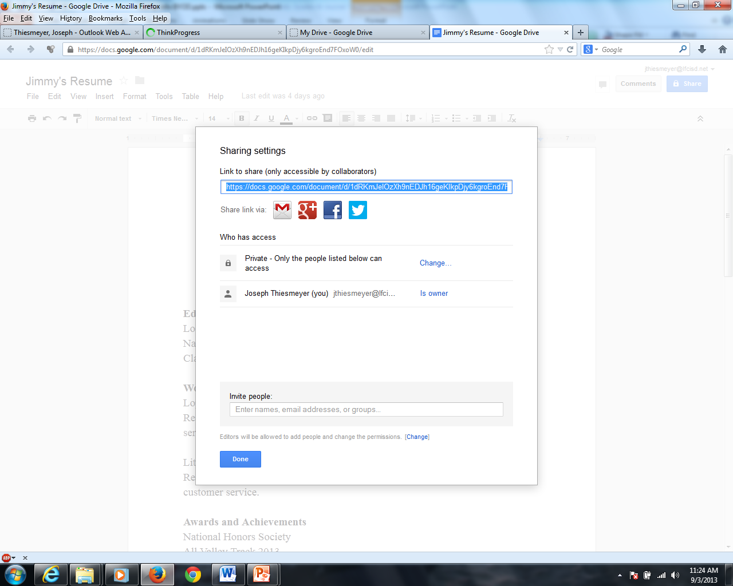
Enter the email address of the person you wish to share this file with

Slide 19
Why Google Drive?
Almost the same functionality of Microsoft Word.
Free!
All info stored in the “cloud” – no more carrying around USB flash drives…and losing them – your stuff will never get lost – ever!
Free!
All info is auto saved with every key stroke, so no more catastrophic data loss.
It’s free!
You can share files with your teammates/teachers to collaborate in real time and from any distance.

