Slide 1
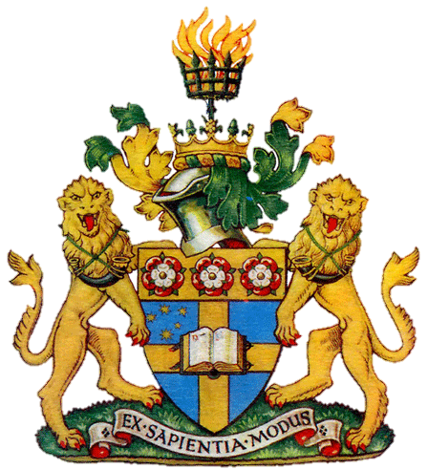
The Heraldic Tradition: Coat of arms

Slide 2
History
Coats of Arms date to the early Middle Ages. In the early twelfth century, helmets and other armor began making it difficult to tell armed warriors apart. The solution was for each knight or soldier to paint something personal on their shield. These designs were important in battle, but they also functioned like team uniforms when knights met in tournaments. Over time, shield emblem designs became enduring symbols of their owners, and of their owners' families.
Heraldry is a special system of identification that developed during the Middle Ages in order to help distinguish fully armored knights on the battle and tournament field.

Slide 3
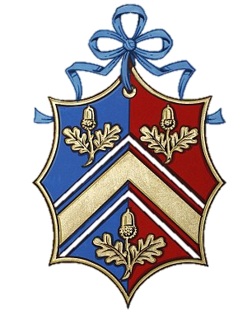
History
Only the oldest male in a family would use the original coat of arms. Any bothers, sisters, nephews, etc. would use a variation of the coat of arms denoting their position.
At first, women didn’t keep a coat of arms. Later, they would, but it would be of a different shape (lozenge or diamond vs. shield).
Male Female

Slide 4
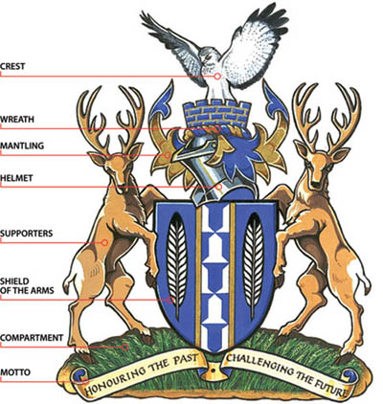
Symbols

Slide 5
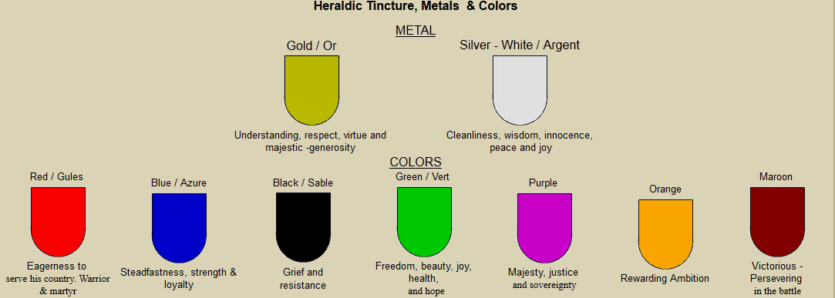
Symbolism - Colors

Slide 6
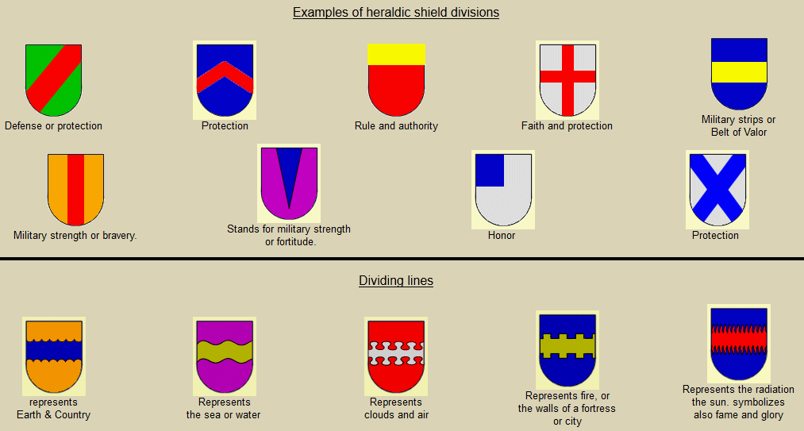
Symbolism – Division of Field

Slide 7
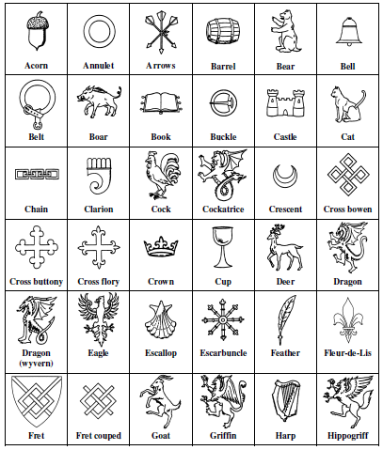
Symbolism - Charges
Sometimes a “charge” (a symbol such as an animal, plant, or item) is used for identification and symbolism

Slide 8
Symbolism - Charges
Animals
Bear - Protectiveness Bee - Industriousness Camel - Perseverance Dog - Loyalty Double Eagle & Eagle - Leadership & Decisiveness Dragon - Defender of Treasure Falcon or Hawk - Eagerness Fox - Cleverness Griffin (part eagle, part lion) - Bravery Horse - Readiness to Serve Lion - Courage Pelican - Generosity & Devotion Raven - Constancy Snake - Ambition Stag, Elk or Deer - Peace & Harmony Tiger - Fierceness & Valor Unicorn - Extreme courage Wolf - Constant Vigilance
Other Symbols
Axe - Dutiful Bridge - (signifies a governor or magistrate) Crescent - Enlightenment Crosses - Christian sentiments Crown - Authority Fire - Zeal Flaming Heart - Passion Fleur-de-lys (stylized Iris flower) - Purity (associated with France) Hand - Faith, Sincerity & Justice Heart - Sincerity Horns & Antlers - Fortitude Lightning – Decisiveness
Moon - Serenity Oyster Shell - Traveler Ring - Fidelity Scepter - Justice Star - Nobility Sun - Glory Sword - Warlike

Slide 9
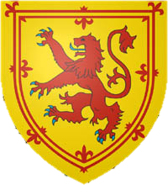
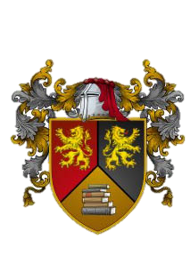
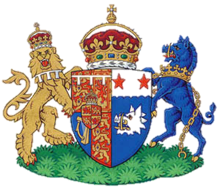
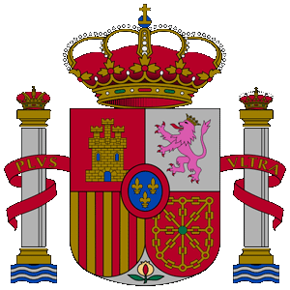
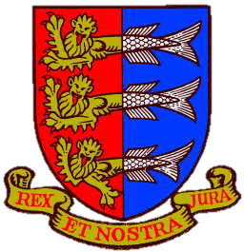
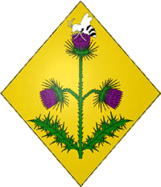
Samples

Slide 10
Assignment
Create your own coat of arms
It must include
1 – 3 colors
Your family name
A motto
A brief description including symbolic choices and meaning
It can include
A division of field
1 or more charges
You can choose either a male or female escutcheon
Extra credit to anyone attempting a full coat of arms (including supporters, helm, & crest)

