Slide 1
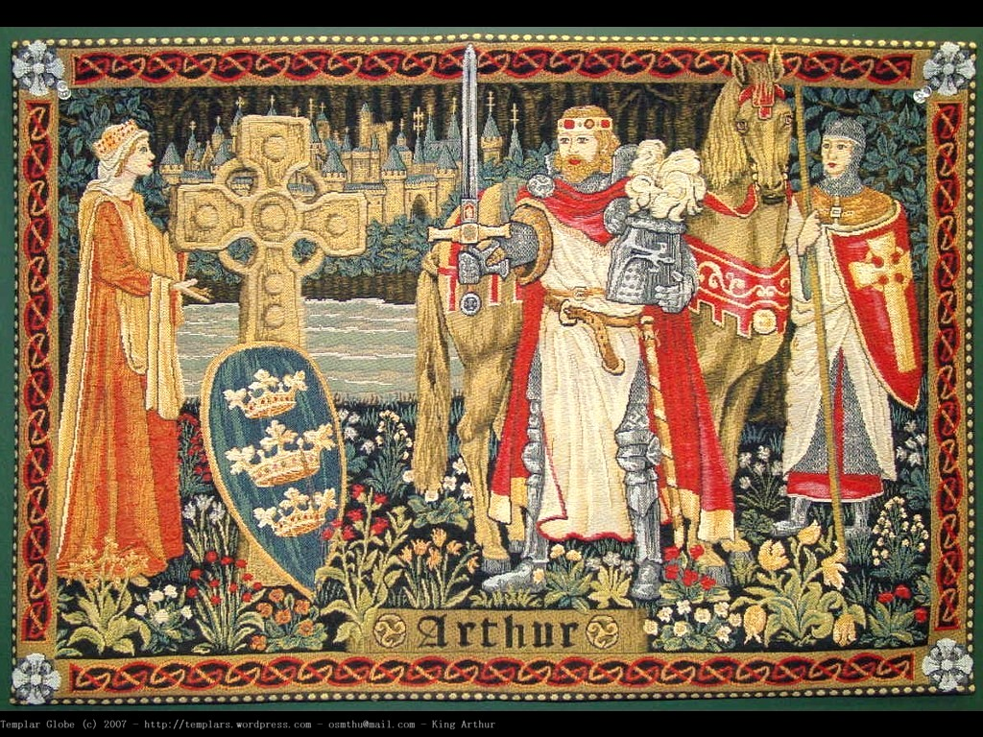
Medieval Romance
&
The Arthurian Legends

Slide 2
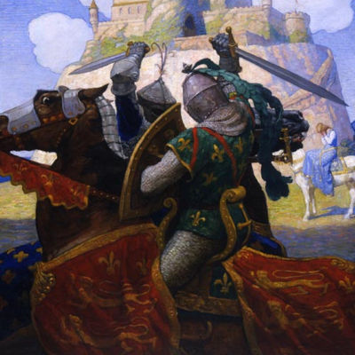
Romance Literature of Medieval Britain
Focus
Centered around the hero-knight
Chivalry
Courtly Love
Supernatural Elements
Repetition of Motifs

Slide 3
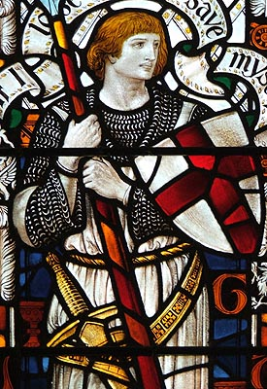
The Hero-Knight
1. Birth of a great hero is shrouded in mystery
2. He is reared away from his true home in ignorance of his real parents.
3. For a time his true identity is unknown
4. After meeting an extraordinary challenge, he claims his right
5. His triumph benefits his nation or group.
6. Is a conquest of good over evil

Slide 4
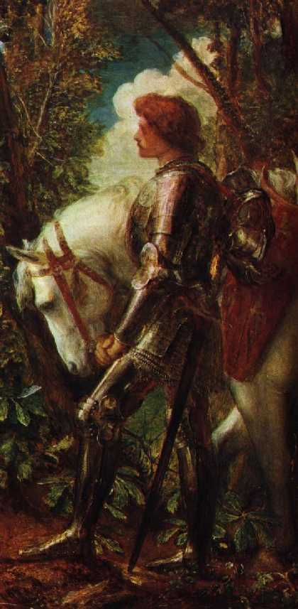
Chivalry
Chivalry was a system of ideals and social codes governing the behavior of knights.
  Knights had to
    be able to ride well, use weapons, and observe certain rules of warfare
    be loyal to their lord, even if it meant death
    defend the Christian faith, even if it meant death
    help any person in need
    act with courtesy toward women of rank

Slide 5
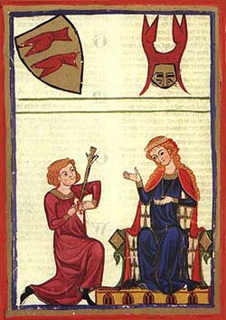
Courtly Love
Courtly love was an aspect of chivalry that encouraged nobles and knights to improve themselves by adoring a particular lady.
  A knight seldom “adored” his own wife.
  The adored lady remained pure and out of the knight’s reach—he served and entertained her and gave her gifts.

Slide 6
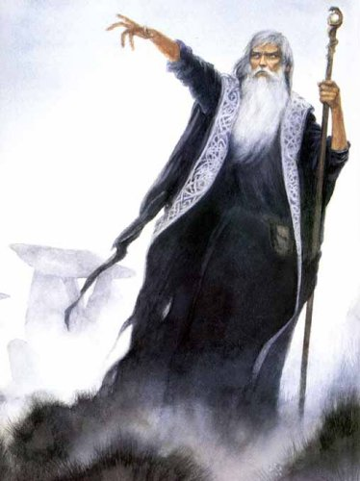
Supernatural Elements
Hero’s birth of mysterious or supernatural origins
Contains mythical or supernatural entities/beings
Contains elements of magic or supernatural occurrences
Elements of Christianity mixed with pagan mythology

Slide 7

Repetition of Motifs
The number three or multiples of three
    Already seen in The Canterbury Tales
      27 pilgrims (minus host & narrator) 3 Rioters, old woman lists 3 reasons the knight would object
A year and a day as a time frame
  365 + 1 = 366 is divisible by 3
    Already seen in The Canterbury Tales
      Knight is given a year and a day to complete his task
Christianity mixed with pagan themes

Slide 8
The Arthurian Legends
First chronicled in the Historia Brittonum by the Welsh monk Nennius (830 A.D.)
  Refers to Arthur as a warrior, not a king
  Places Arthur in the 5th century as a unifying force for the native Britons against the invading Saxons
  Chronicles 12 of Arthur’s battles

Slide 9
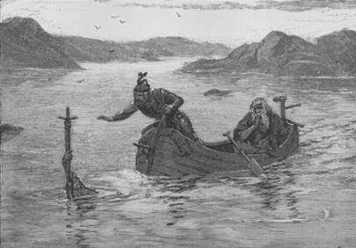
The Arthurian Legends
More thoroughly described in Geoffrey of Monmouth’s (also a Welsh cleric) Historia Regum Brittaniae (1133 A.D.)
  Formed the foundation of what is now considered the Legends of King Arthur

Slide 10
The Arthurian Legends
In 1155 the French poet Maistre Wace added The Round Table.
Chretien de Troyes, also French, wrote five Arthurian stories between the years 1160 and 1180. He developed the theme of chivalry and dwelt on the subtleties of courtly romance.
Another French man, Robert de Boron from Burgundy, developed the idea of the Quest for the Holy Grail.
Back in England at about the same time, (around 1200AD) the priest Layamon wrote the story in English - the first time it had appeared in this language. In his version Arthur did not die from his wounds, he remained on the Isle of Avalon - to return some time in the future.

Slide 11
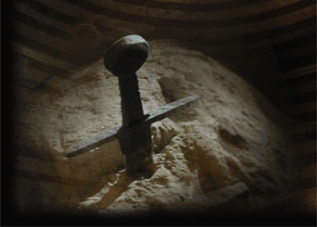
The Arthurian Legends
Le Morte D’Arthur, by Sir Thomas Malory, compiles the most extensive telling of the Legends of King Arthur.
  A collection of 8 stories that piece together the rise of Arthur, Excalibur, his knights of the Round Table and their tales, Guinevere, and the death of Arthur
  Clearly places King Arthur in Malory’s time

Slide 12
William Caxton
Brought the printing press (invented in Germany by Johannes Gutenberg in 1439 ) to London in 1475
Le Morte D’Arthur was one of the first books printed in English (The Canterbury Tales was first)
The printing press helped solidify and codify the English Language by establishing a means of standardizing spelling and grammar en masse

Slide 13
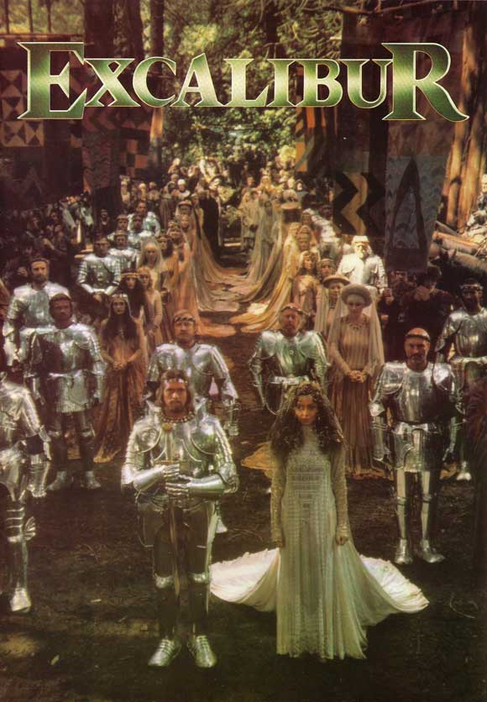
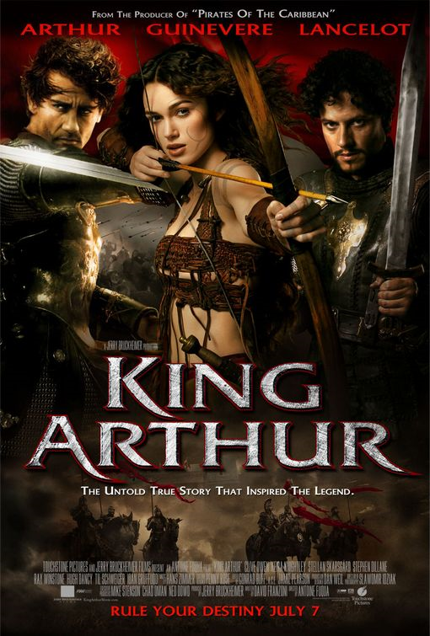
The Legends of King Arthur in Pop Culture

Slide 14
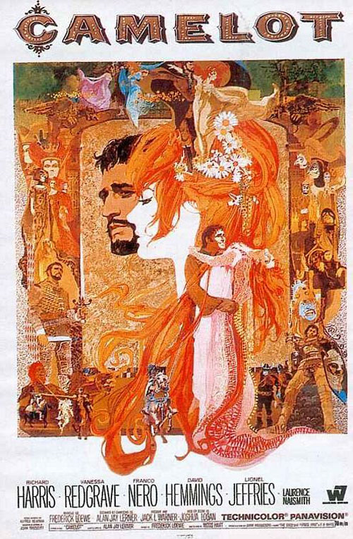
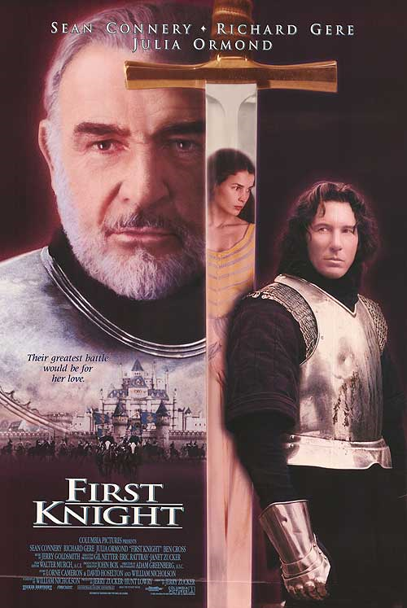
The Legends of King Arthur in Pop Culture

Slide 15
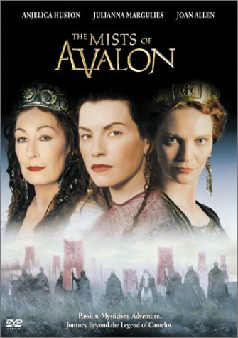
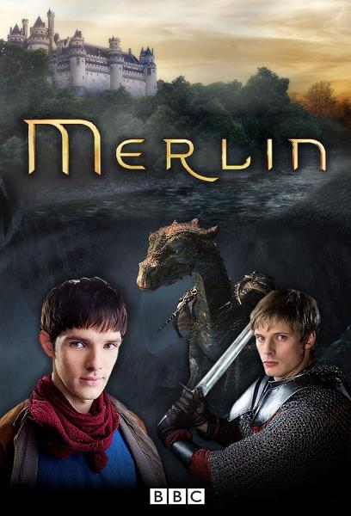
The Legends of King Arthur in Pop Culture

Slide 16
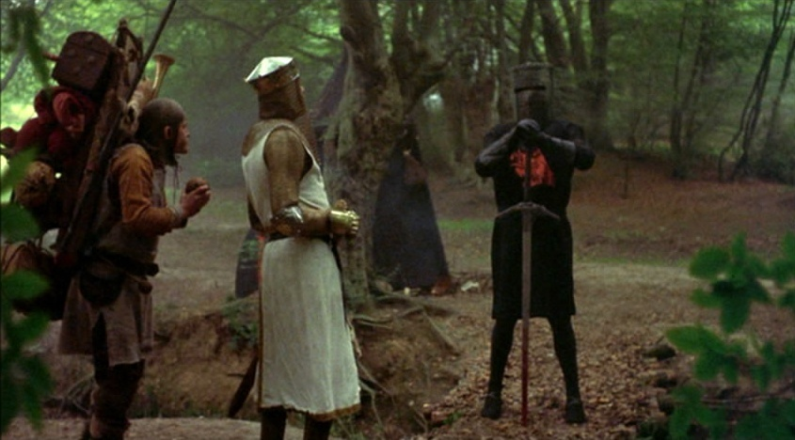
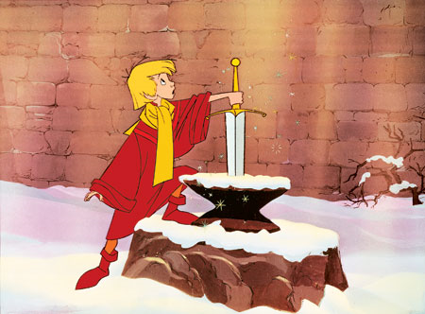
The Legends of King Arthur in Pop Culture

