Slide 1
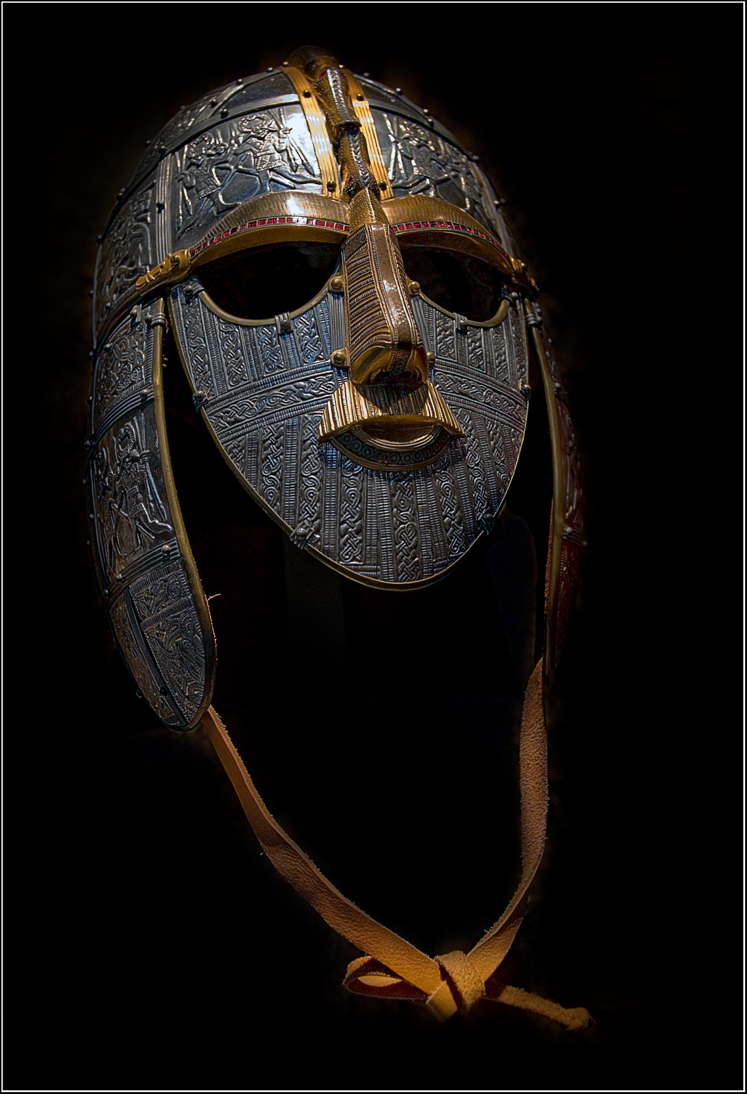
The Anglo-Saxons and The Epic Hero The Epic of Beowulf

Slide 2
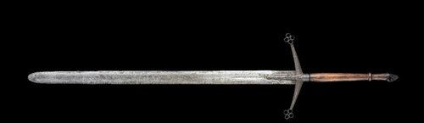
Anglo-Saxon Life - Warriors
Small groups lived under a “chief” (king/warlord)
Warfare was a way of life
Bravery and loyalty were highly honored
Bravest followers rewarded with plunder & fame
Glory was the highest achievement

Slide 3
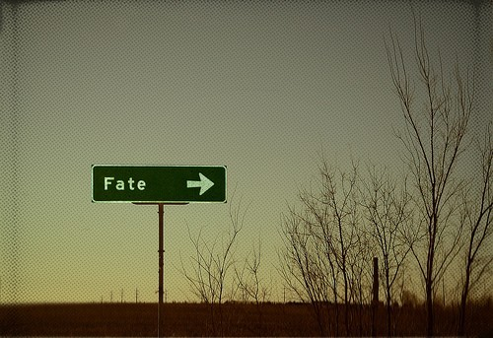
Anglo-Saxon Life - Wyrd
Lived by a philosophy called wyrd – a belief in fate – that all events were predestined and were purposeful
Life was harsh, difficult, and short – the ultimate and inescapable fate was death
Only option was to face fate with courage and strength

Slide 4
Anglo-Saxon Life – Mead Halls
Communities congregated in mead halls
A social gathering place
Eating/Drinking
Socializing
Entertainment (telling stories)
Mead – an alcoholic beverage made from fermented honey
Honeymoon – newlyweds dink mead everyday for one full moon (one month) to ensue good luck
Scops (minstrels) performed songs of heroic deeds celebrating:
Strength
Loyalty
Courage
Provided models to emulate
and a goal to pursue

Slide 5
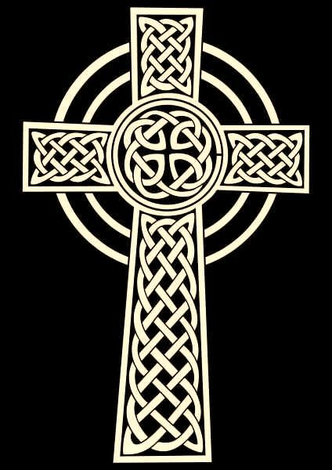
Anglo-Saxon Life – Christianity
Warriors sought immortality through fame of strength/bravery – Christianity added the idea of true immortality
Major impact on literature in 2 ways
1. Integrated into plot – having
God’s favor/Biblical elements
2. Texts being reproduced in monasteries

Slide 6
The Epic
A long narrative poem that relates the great deeds of a larger-than-life hero who embodies the values of a particular society
Examples: The Iliad, Odyssey, Gilgamesh
Good vs. Evil
On a larger-than-life scale
Written in a heightened language

Slide 7
The Epic - Characteristics
Hero is a great leader; strongly aligned with the values of their society/culture
Setting on a grand scale, often including supernatural realms
Hero performs great deeds/undergoes a great quest
Supernatural beings have a hand in the plot
Told in a heightened language

Slide 8
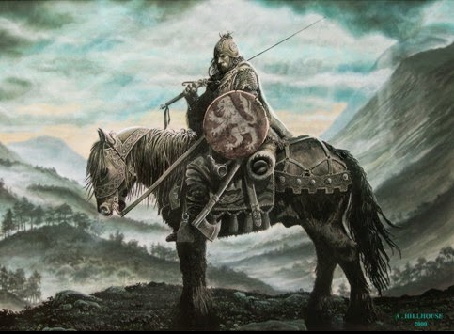
The Epic – The Epic Hero
Larger than life
Embodies societal values such as:
loyalty, valor, courage,
sense of justice, dignity, persistence
Undertakes a quest or journey
Live on after death
(immortality through fame)
Deeds set them apart from regular people
Overcomes great obstacles while retaining humanity
Experiences normal human emotions

