Slide 1
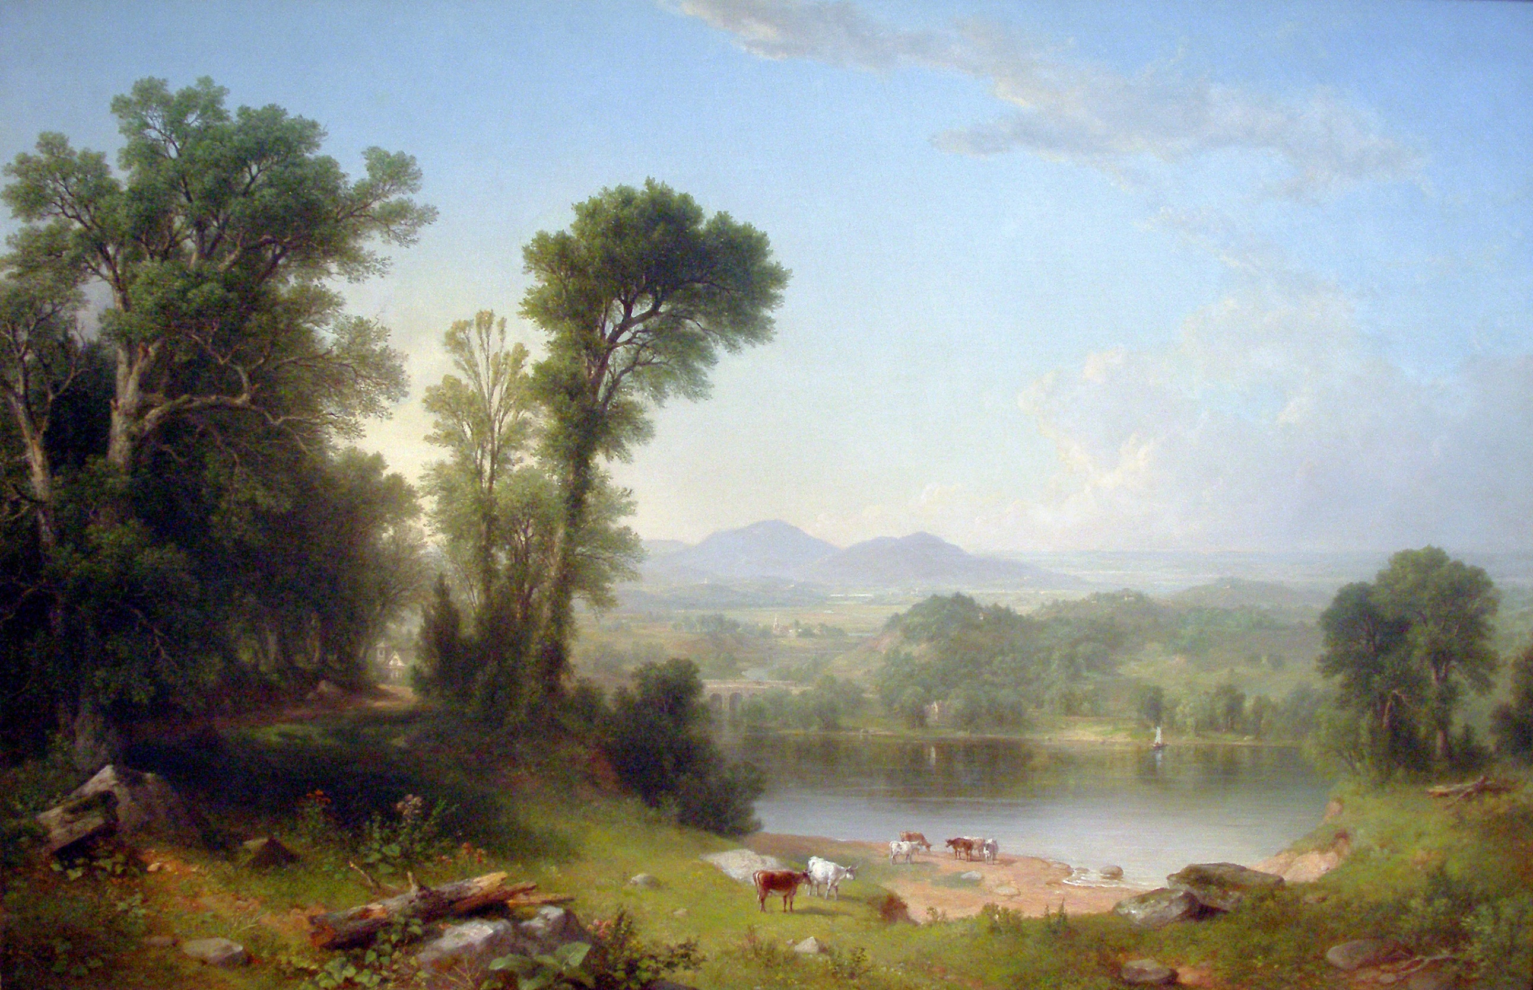
The Pastoral

Slide 2
The Pastoral
Based on the word Pastor which is Latin for Shepherd
Deals with shepherds and the rustic life
Highly conventionalized poetic style
Presents an idealized (romanticized) view of the rustic life rather than a realistic view
Dates back to the 3rd century B.C.

Slide 3
The Pastoral
Common topics include
  Love & Seduction
  Death & Mourning
  Corruption of the city/court vs. the purity of nature

Slide 4
The Pastoral
Shakespeare & his contemporaries revived & imitated this classical form
Most famous pastoral of the age: Christopher Marlowe’s “The Passionate Shepherd to His Love”

