Slide 1
Works Cited Page

Slide 2
Works Cited Information - Websites
Page Title – the page you’re looking at
Site title – the title of the website that page is on
Author – look for it; if not found, leave blank
Last revised – revision/update date – if not found, leave blank
Date visited – today’s date
Organization – only for .edu, .gov, or .org
URL – http://www.example.com/page.html
Stay away from Wikipedia & unprofessional sites!!!

Slide 3
Sample Works Cited Entry
Last Revised/Updated
(if available)
Smith, John. "Article Title." Site Title. Organization, 13 Aug. 2011. Web. 30 Oct. 2012. <http://www.example.org/page.htm>.
Author’s name (if available)
Date Viewed
URL

Slide 4
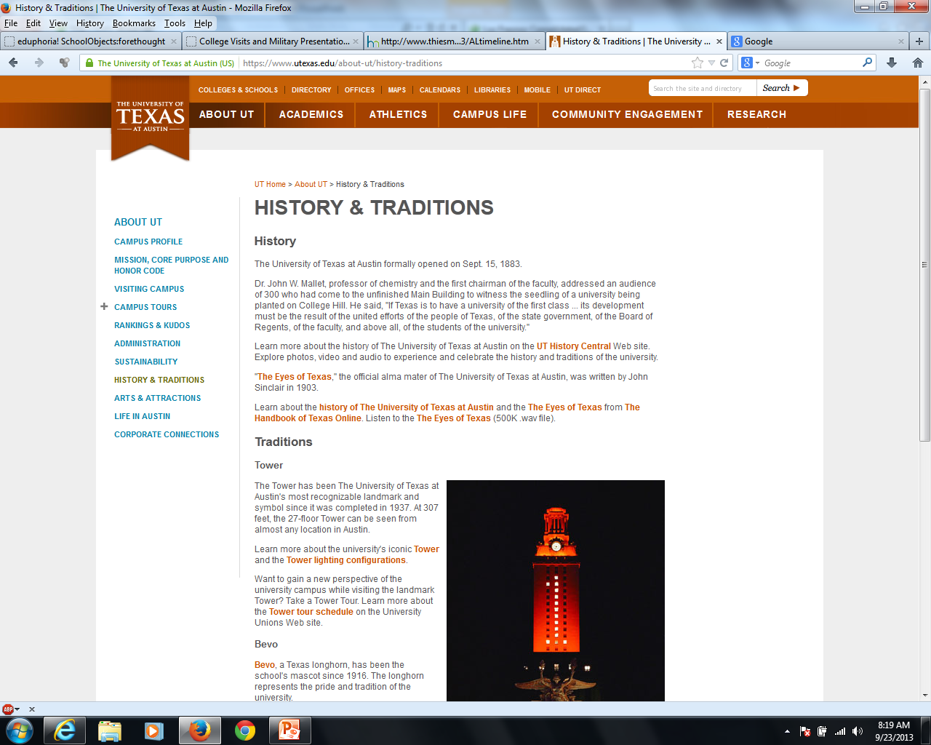
URL
Site title
Page Title

Slide 5
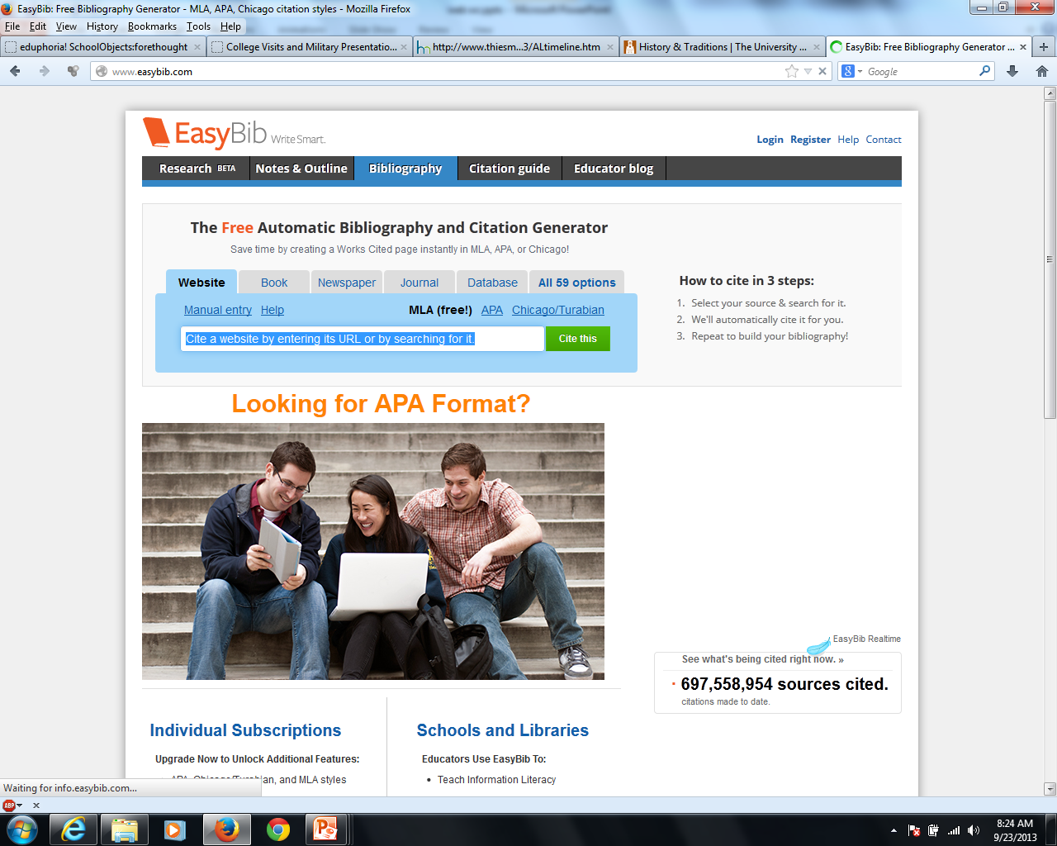
Enter URL here

Slide 6
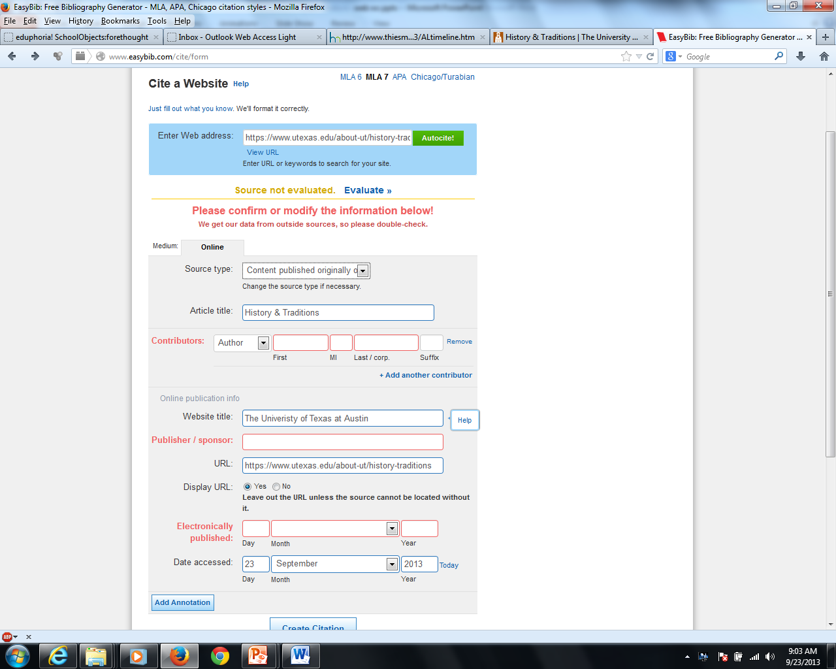
Page title
Page author (if available)
Site title
Organization
Enter name of university
Date published/modified (if available)
Date accessed
Click to create citation
Click to create citation

Slide 7
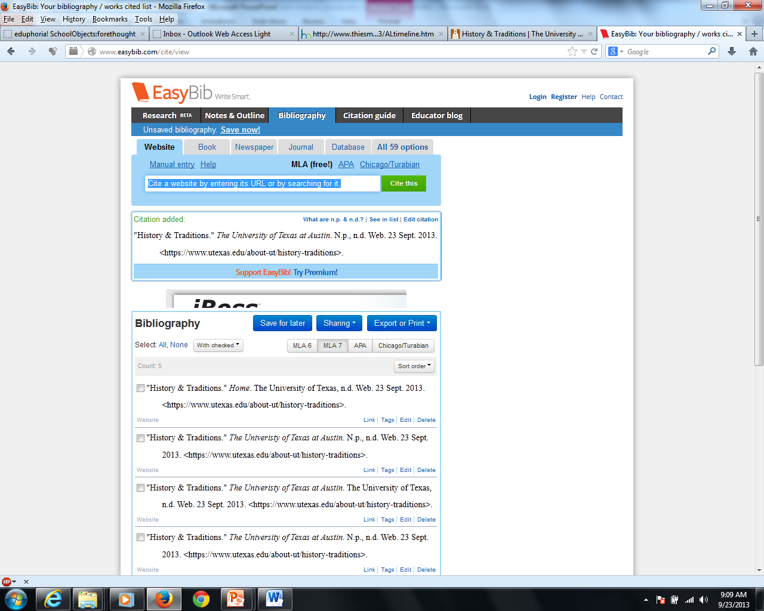
Your works cited entry: copy and paste to your sources page

Slide 8
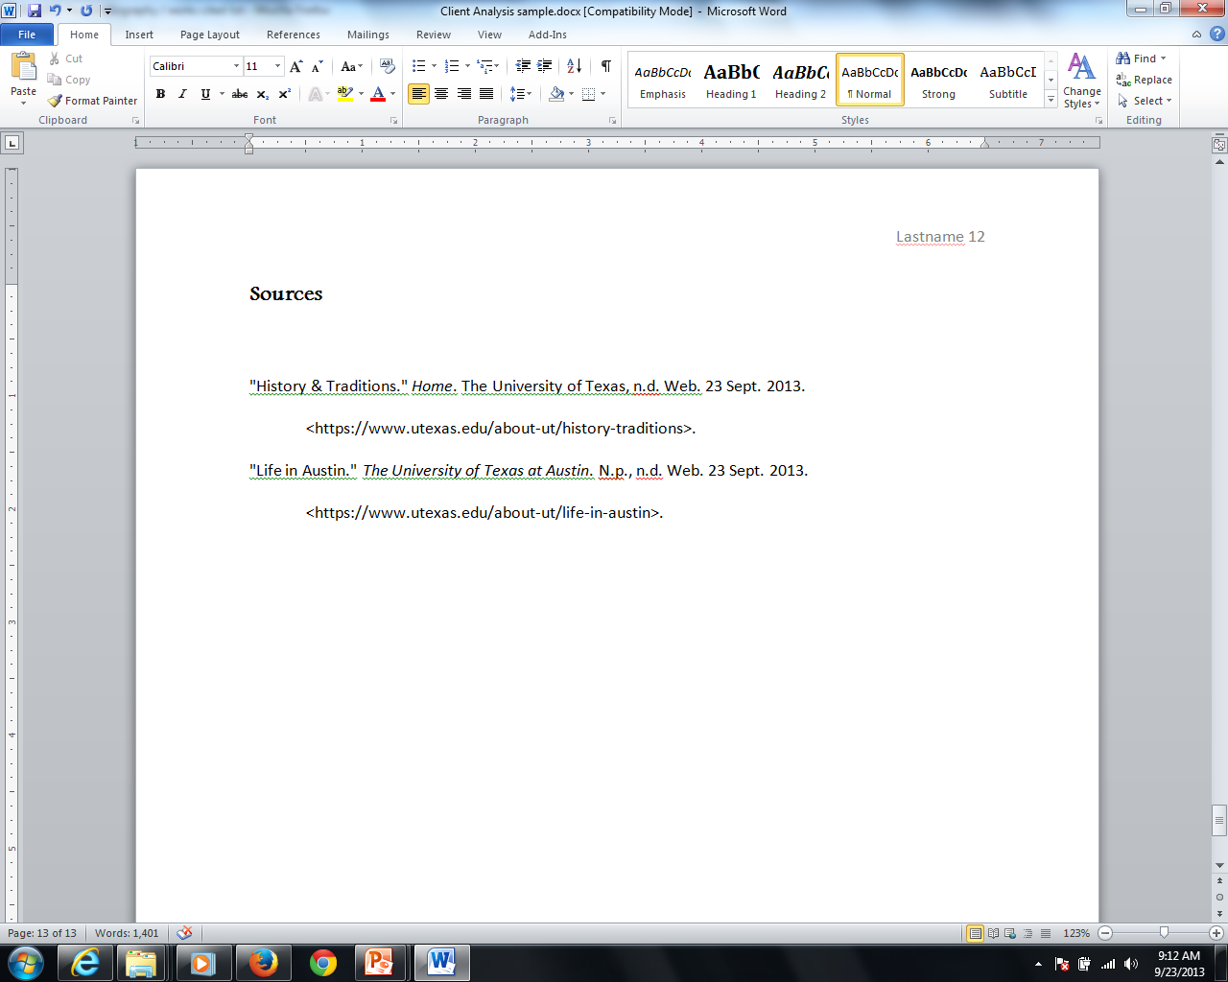
Arrange alphabetically according to first letter

